Slide 1

Irish seafood carbon footprint study
Ben Dallaghan
Economic & Strategic Services Unit
BIM

Slide 2


Sustainability Credentials
Finance
Markets

Slide 3

Irish seafood carbon footprint study
Calculate baseline greenhouse gas emissions for the Irish seafood sector
Identify carbon ‘hotspots’ in seafood supply chains

Slide 4








Project Collaboration

Slide 5
Key findings for Irish seafood
Relatively low carbon emitting sector. Total emissions are 396,207 tonnes CO₂ eq.
Equates to 1.76% of (compared to) agriculture emissions
Irish seafood is a ‘low carbon food’
Irish seafood sector is diverse
The carbon footprint depends on species and methods of production

Slide 6
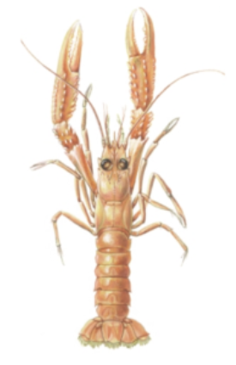
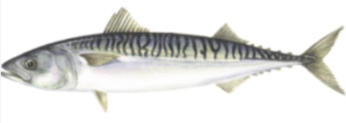
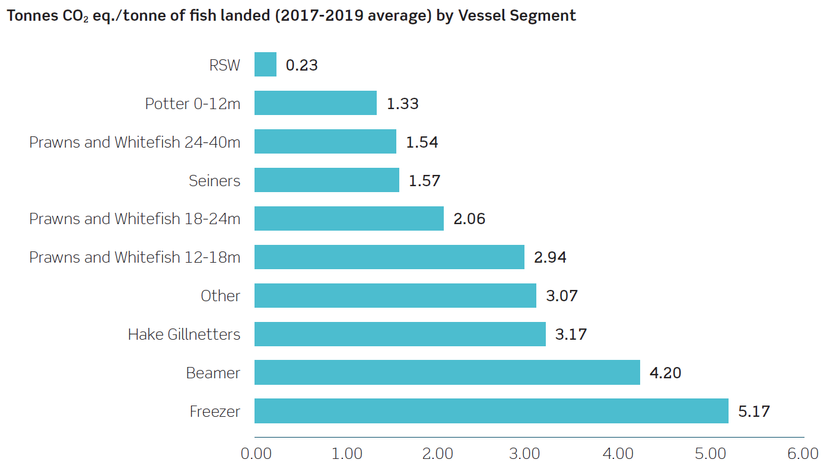
Fishing Sector Carbon Emissions
Irish fishing is a relatively low GHG emission sector
Fishing sector 83.5 % of total seafood GHG emissions
90% of GHG emissions related to diesel
The pelagic fishing fleet has particularly low carbon footprint
Carbon footprint of demersal fishing higher than pelagic fisheries

Slide 7
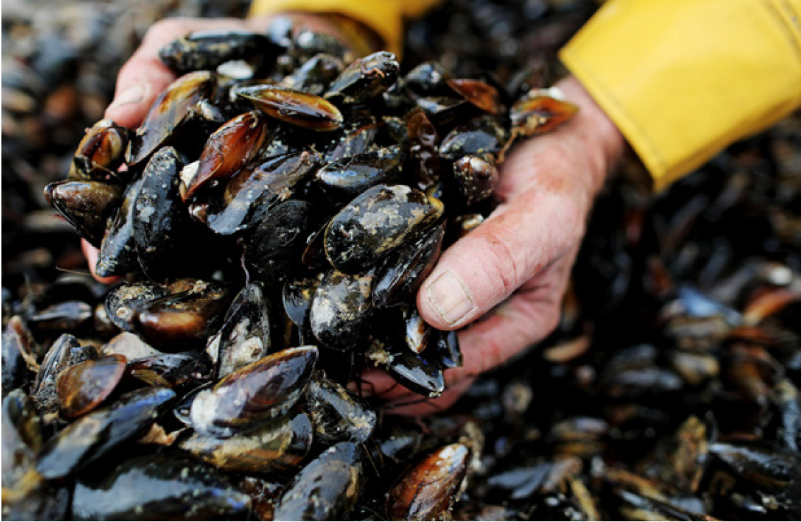
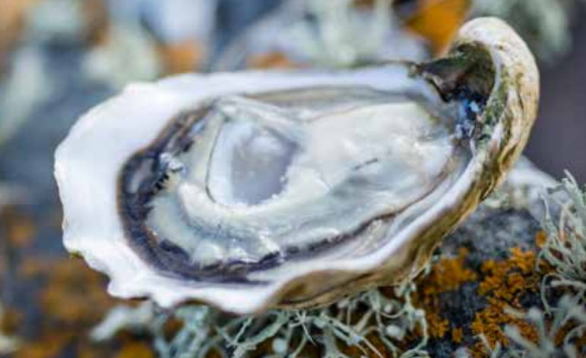
Aquaculture Sector Carbon Emissions
A low GHG emission sector
Contributes 16.5% of total Irish seafood GHG emissions
Shellfish production has exceptionally low carbon footprint
Rope mussel 0.107 t CO2 eq./t
Oyster 0.235 t CO2 eq./t
Bottom grown mussel 0.824 t CO2 eq./t
Irish farmed salmon 3.88 t CO₂ eq./t

Slide 8
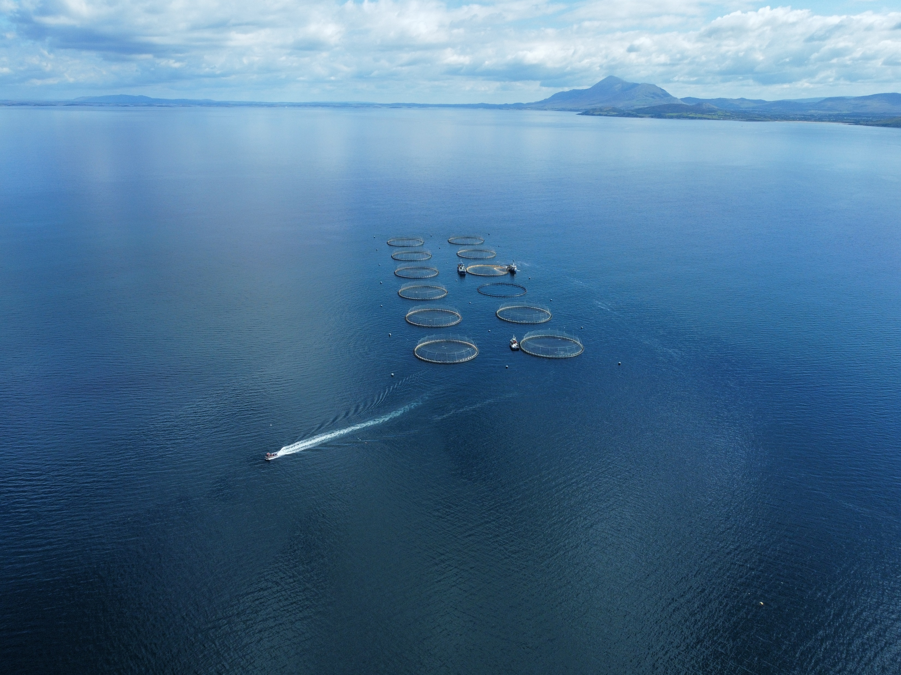
Take Home Messages
Baseline study
Seafood ‘part of solution’ Producing low carbon nutritious food
Diesel usage generally, salmon feed and ‘circularity’ are key

Slide 9
Thank You
Ben Dallaghan, Economic & Strategic Services Unit
ben.dallaghan@bim.ie

