Slide 1
Recent trends in ocean climate conditions around Ireland and services to aquaculture
IFA Aquaculture meeting
20th March 2025
Glenn Nolan, Diego Pereiro and the OCS team
Ocean, Climate & Information Services (Marine Institute)

Slide 2
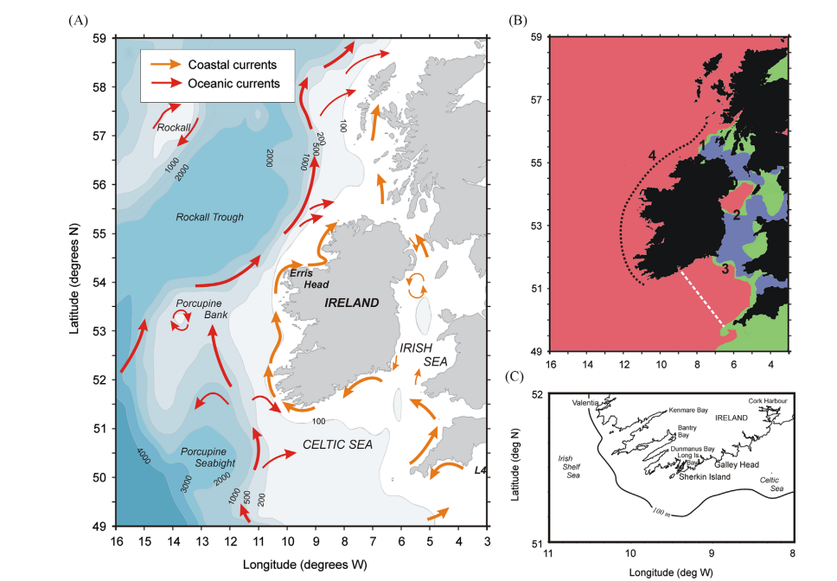
Ocean circulation around Ireland (Raine, (2014)

Slide 3

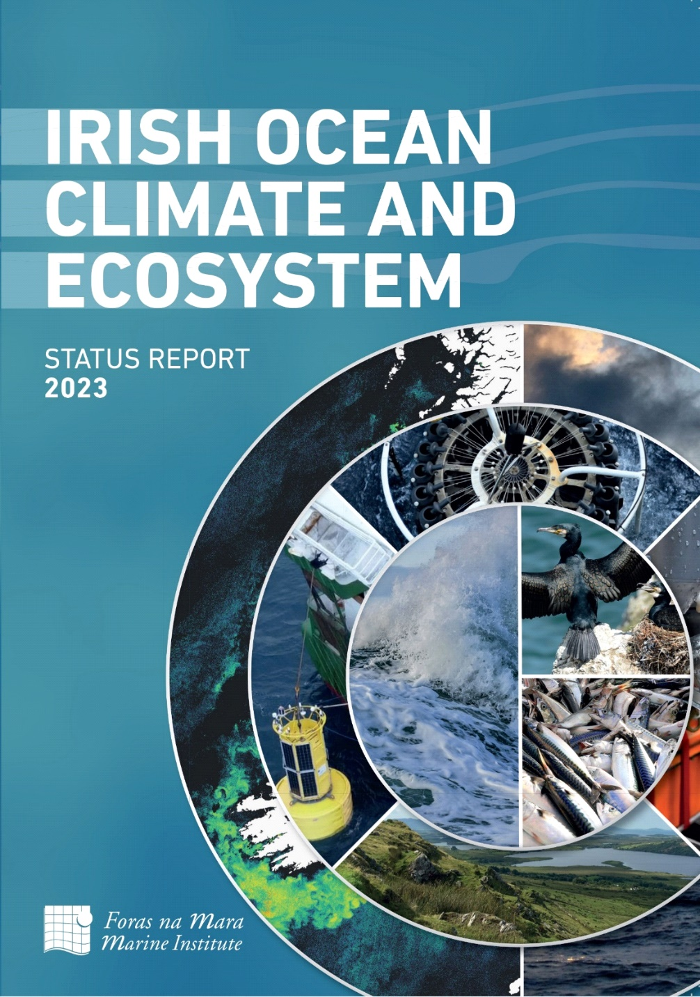
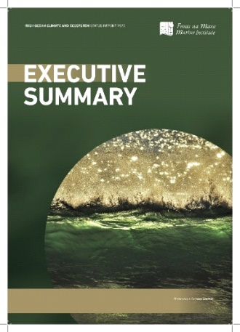
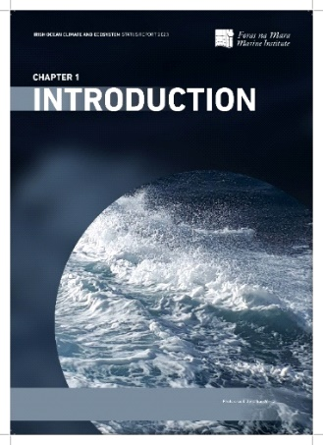
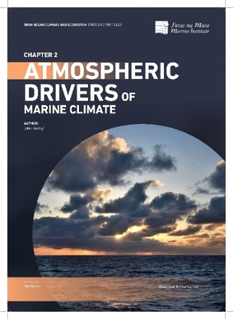
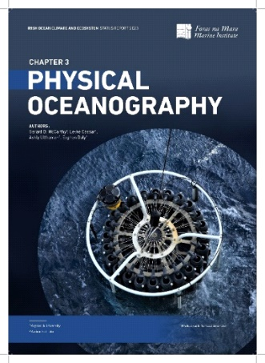
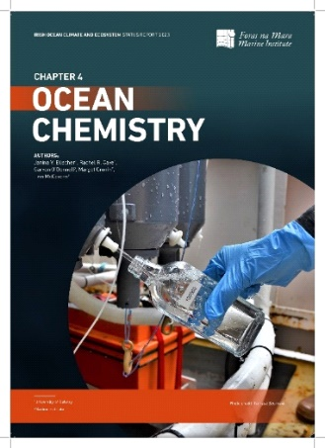
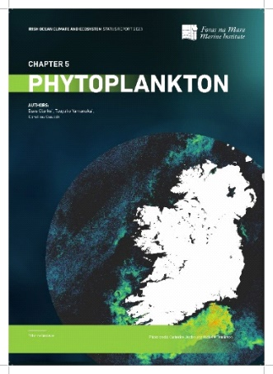
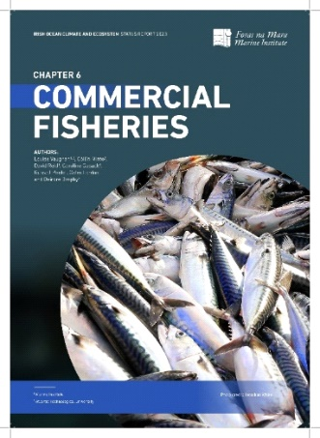
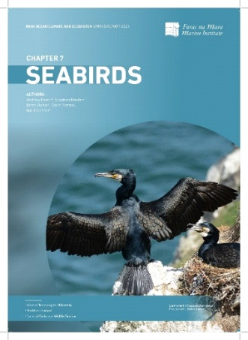
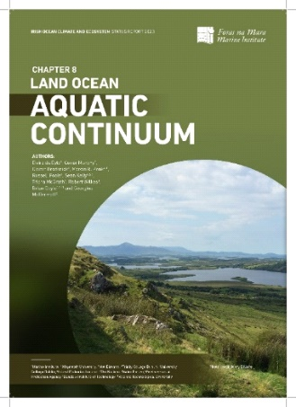
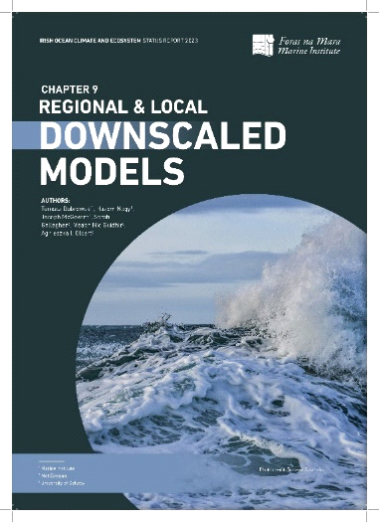
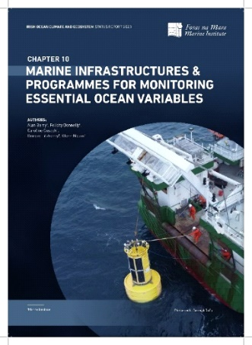
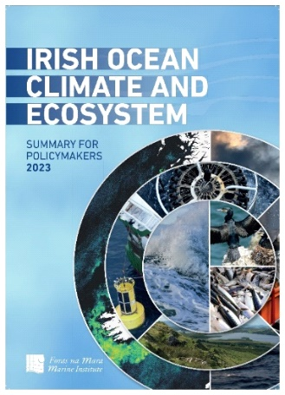
https://oar.marine.ie/handle/10793/1844
Notes:
Atmospheric drivers
Physical Oceanography
Ocean Chemistry
Phytoplankton
Commercial Fisheries
Seabirds
Land ocean aquatic continuum
Ocean modelling
Infrastructure

Slide 4
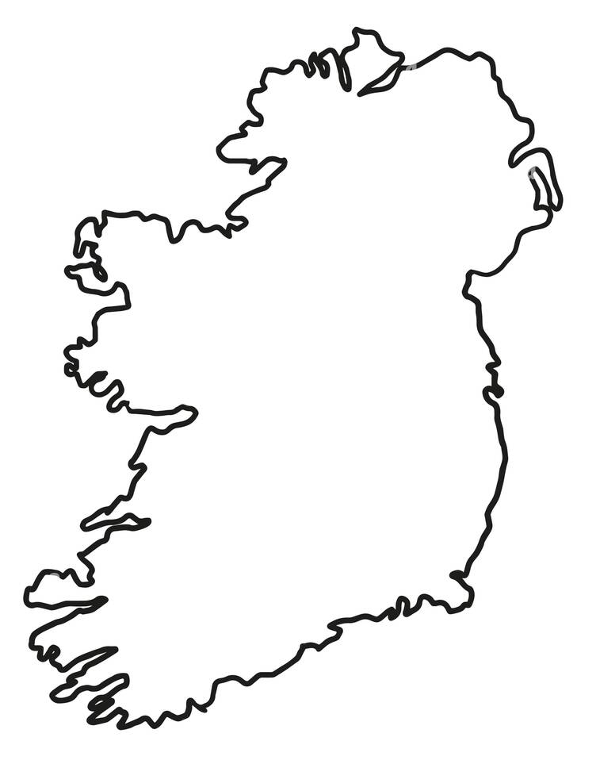
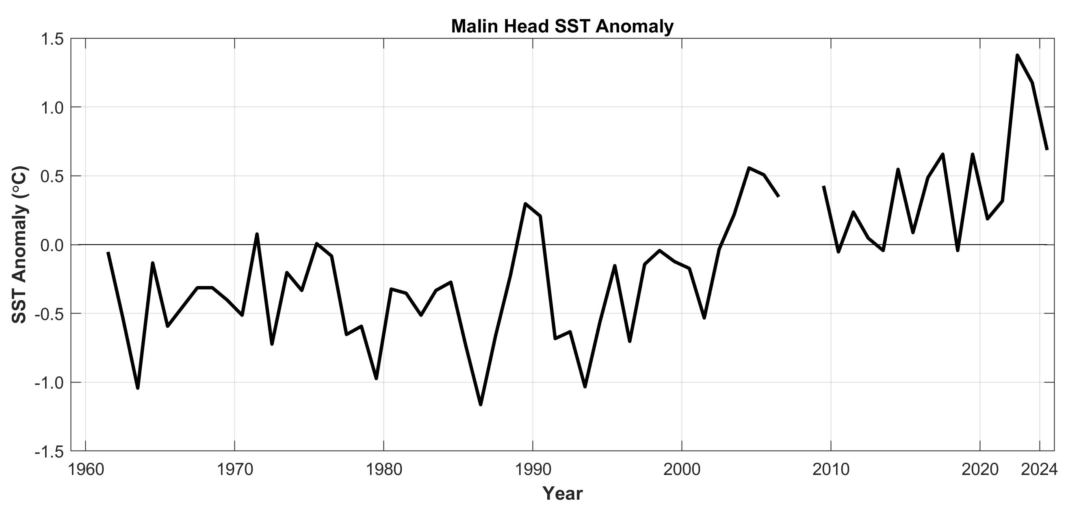

Northern Ireland: Malin Head [Inshore coastal station]
Inshore SST observations – 61 year dataset
2024 SST annual mean °C = 11.47; SST Anomaly °C = 0.69;
SST Anomaly Normalized °C = 1.52 SD higher than normal
Malin Head
1991-2020 Reference Pont = 10.78 °C; Standard Deviation = 0.45
Region: Celtic Seas 4a
Data source: Marine Institute / Met Éireann - Ireland
Data shown here is from 1963 to 2024

Slide 5
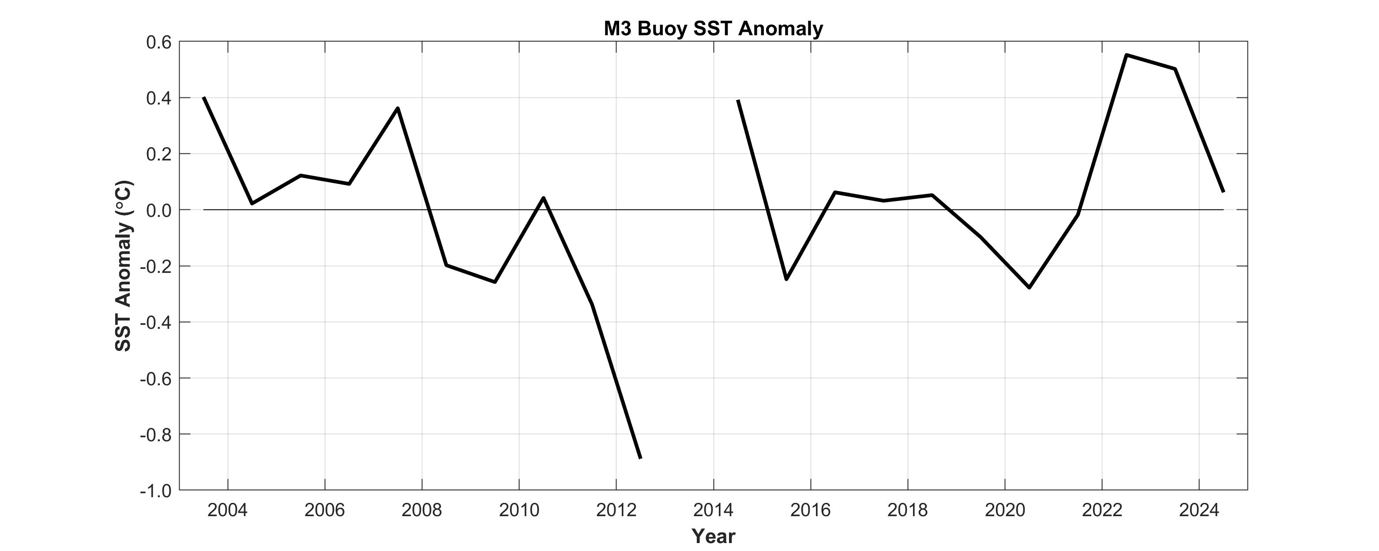
Offshore site SST observations – 21 year dataset
SW Ireland: M3 [Irish Marine Data Buoy ~ 50 Km offshore ]
2022 SST annual mean = 13.08 °C; SST Anomaly °C = +0.06;
SST Anomaly Normalized °C = 0.24 SD higher than normal
2003-2020 Reference Pont = 13.02 °C; Standard Deviation = 0.26
LTM (2003-2020) 18 years long
M3 Buoy
Region: Celtic Seas 4a
Data source: Marine Institute / Met Éireann - Ireland
Data shown here is from 2003 to 2024

Slide 6
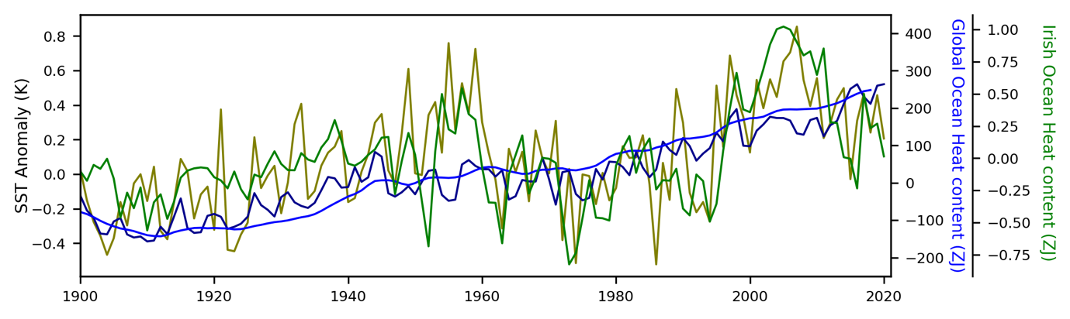

Societal Concerns: 1. Ocean Heat Content and sea level
Slide courtesy of Gerard McCarthy (Maynooth University)
Notes:
Part of our role is to understand how large scale changes in ocean currents, temperature and salinity (saltiness) affect the ecosystems that live in the ocean. This involves continuous monitoring using ships, buoys, satellites and autonomous glider vehicles.

Slide 7
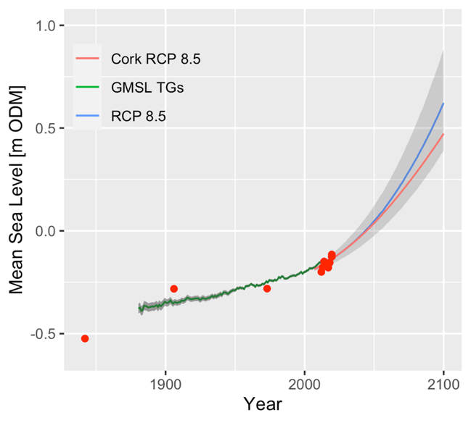
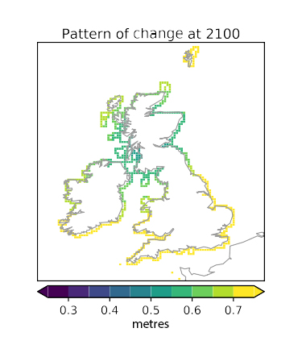
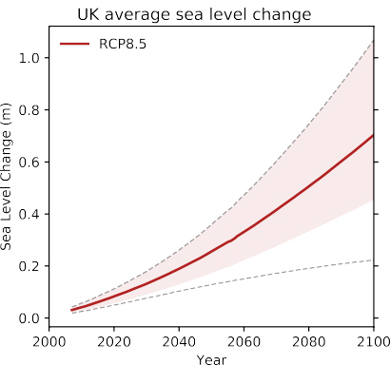
Predicted Sea Level Rise by 2100
The upper range for the latest sea-level rise projections is higher than previous estimates,
implying increased coastal-flood risk
Courtesy: Pugh et al (2021)
Sea-level rise around Ireland and Britain under a “business-as-usual” scenario [RCP 8.5 ]
Source: Palmer, M., Howard, T., Tinker, J., Lowe, J., Bricheno, L., Calvert, D., Edwards, T., Gregory, J., Harris, G., Krijnen, J. and Roberts, C. (2018) UKCP18 Marine Report, Met Office Hadley Centre, Exeter.
Notes:
Sea level rise will not happen uniformly around the coast of Ireland as can be seen by the figure on the right hand side. This suggests that sea level rise will be more significant off the south coast (yellow colour) than off the north and east coast (due to differences in glacial isostatic adjustment if anyone asks i.e. land rebound from Ice sheets)

Slide 8
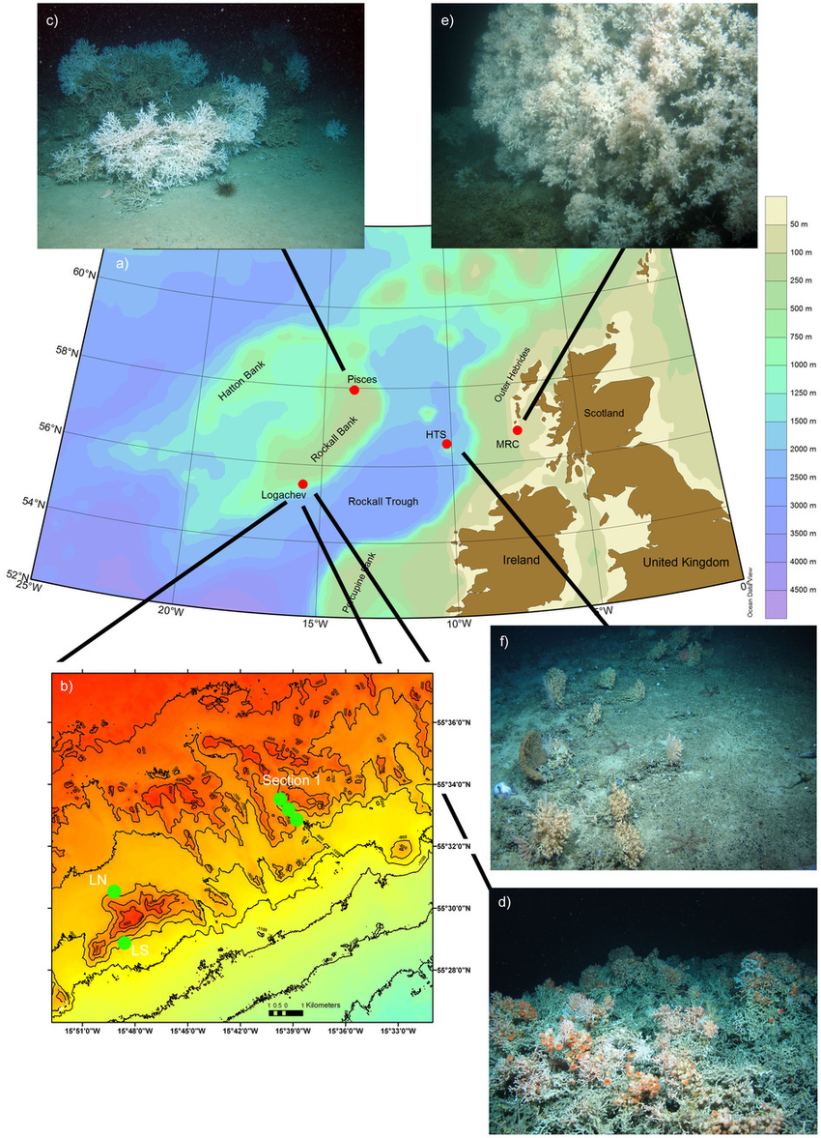
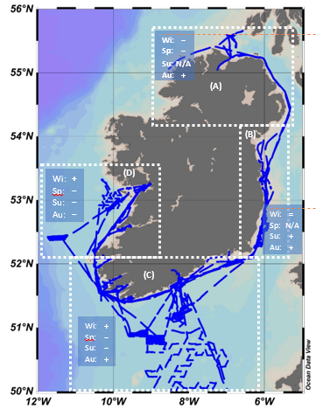
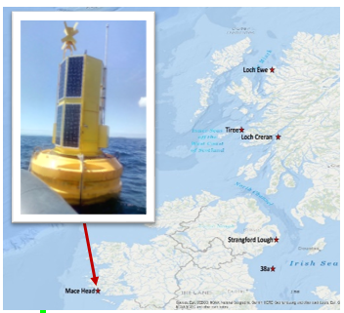

Societal Concerns: 2. Health of Marine Ecosystems
Changes in Water Chemistry:
The Carbonate System - Ocean Acidification
Source: www.nature.com/articles/srep03671
Notes:
You wont have time to go into all the detail below: keep it high level
Ocean acidity:
The ocean absorbs around 30% of the annual anthropogenic emissions of CO₂, thereby helping to alleviate additional warming. The ecological costs to the ocean, however, are high, as the absorbed CO₂ reacts with seawater and changes the acidity of the ocean. There has been an overall increase in acidity of 26% since the beginning of the industrial revolution.
Monitoring ocean carbon uptake and acidification
Sustained ocean observations, especially of ocean acidification are vital for sustainable development. Ocean acidification has been recognized as vital to sustainable development by the United Nations and the Sustainable Development Goal (SDG) 14 and its indicator 14.3.1. Under the custodianship of the IOC of UNESCO, this indicator mandates measurement of average marine acidity (pH) at representative sampling sites globally.
Several JCOMM networks, such as ship based oceanographic measurements, multidisciplinary moorings, autonomous profiling floats and gliders, provide in situ ocean carbonate chemistry measurements, helping to sustain and expand global ocean acidification observations.
Coordinated and continuous monitoring of the global changes in ocean chemistry enable nations to report on the ocean acidification Global Climate Indicator, as well as the UN SDG target 14.3.
Ocean warming and acidification, loss of oxygen and changes in nutrient supplies, are already affecting the distribution and abundance of marine life in coastal areas, in the open ocean and at the sea floor
Interactions with other stressors (e.g. temperature, toxic metals, oxygen and food supply) and species-specific responses need to be considered to better understand impacts on ecosystems.
Long-term ocean measurements are essential to understand how ocean pH varies over months to decades. The biological impacts of ocean acidification (for ecosystems, fisheries and aquaculture) not only depend on site-specific physical and chemical conditions, but also species physiology, adaptive capacity, food availability and occurrence of other stressors

Slide 9
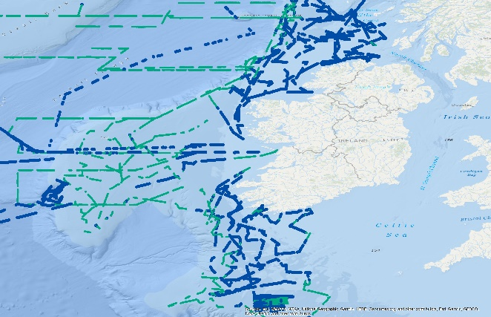
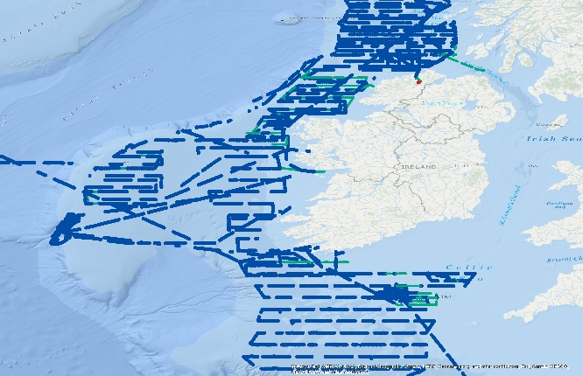
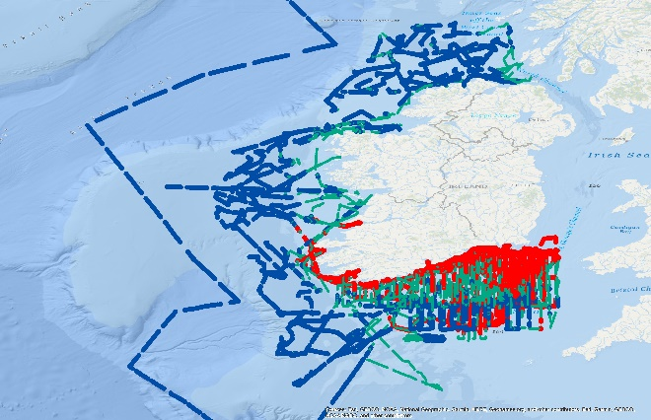
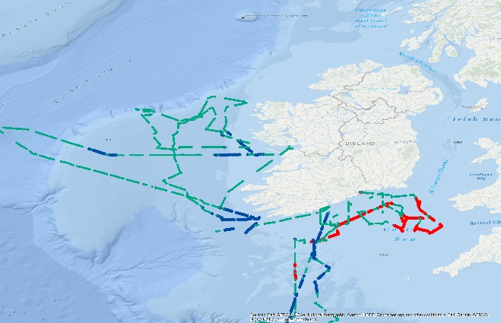
Main Societal Concerns: 2. Health of Marine Ecosystems
Changes in
Water
Chemistry:
The Carbonate System –
Ocean Acidification
Courtesy: Buescher et al
(in prep)
(A) Spring
(B) Summer
(C) Autumn
(D) Winter
= CO₂ sink
= no difference
= CO₂ source
Notes:
You wont have time to go into all the detail below: keep it high level
Ocean acidity:
The ocean absorbs around 30% of the annual anthropogenic emissions of CO₂, thereby helping to alleviate additional warming. The ecological costs to the ocean, however, are high, as the absorbed CO₂ reacts with seawater and changes the acidity of the ocean. There has been an overall increase in acidity of 26% since the beginning of the industrial revolution.
Monitoring ocean carbon uptake and acidification
Sustained ocean observations, especially of ocean acidification are vital for sustainable development. Ocean acidification has been recognized as vital to sustainable development by the United Nations and the Sustainable Development Goal (SDG) 14 and its indicator 14.3.1. Under the custodianship of the IOC of UNESCO, this indicator mandates measurement of average marine acidity (pH) at representative sampling sites globally.
Several JCOMM networks, such as ship based oceanographic measurements, multidisciplinary moorings, autonomous profiling floats and gliders, provide in situ ocean carbonate chemistry measurements, helping to sustain and expand global ocean acidification observations.
Coordinated and continuous monitoring of the global changes in ocean chemistry enable nations to report on the ocean acidification Global Climate Indicator, as well as the UN SDG target 14.3.
Ocean warming and acidification, loss of oxygen and changes in nutrient supplies, are already affecting the distribution and abundance of marine life in coastal areas, in the open ocean and at the sea floor
Interactions with other stressors (e.g. temperature, toxic metals, oxygen and food supply) and species-specific responses need to be considered to better understand impacts on ecosystems.
Long-term ocean measurements are essential to understand how ocean pH varies over months to decades. The biological impacts of ocean acidification (for ecosystems, fisheries and aquaculture) not only depend on site-specific physical and chemical conditions, but also species physiology, adaptive capacity, food availability and occurrence of other stressors

Slide 10
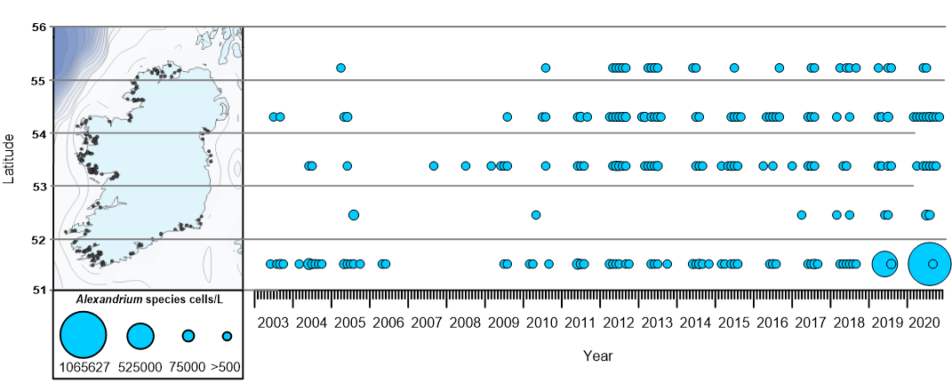
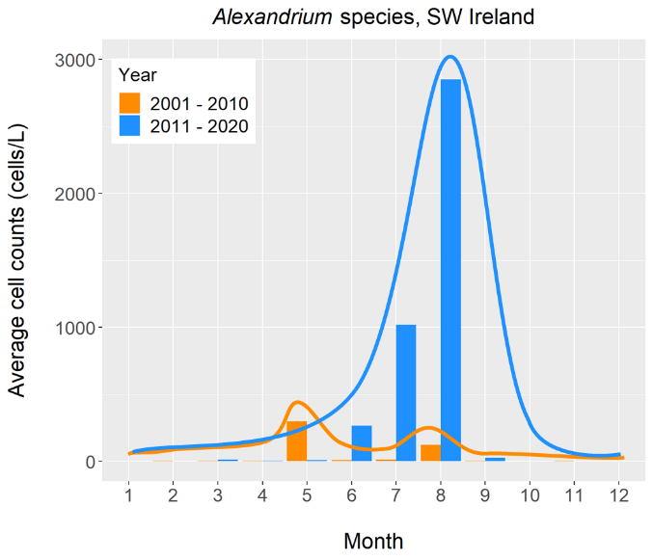
Societal Concerns: 3: Phytoplankton and HABs
Major Societal Concerns: 4. Major Fish Stocks
Update Meeting: 24/09/2021
Louise Vaughan
(Alexandrium, SW
(Courtesy Dave Clarke, Caroline Cusack, Tsuyuko Yamanaka
Notes:
We are already observing changes in the distribution and abundance of some of our key fish species. We are seeing decreases in cold water species like herring and cod and increases in warm water species like hake. A very cursory view could be that we will be eating exotic new species as our climate warms, like the picture on the left shows. We need to understand the implications of such changes in key fisheries in our waters so that we can provide the best management advice to fishers in the future.

Slide 11
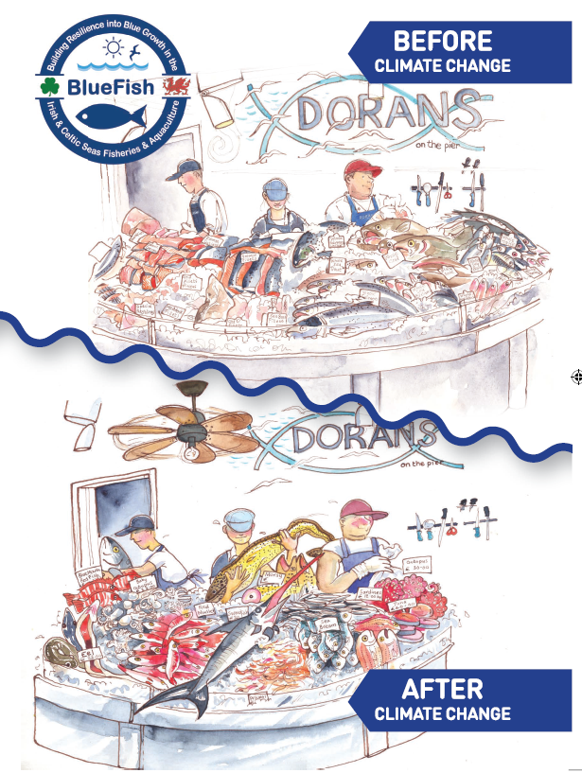
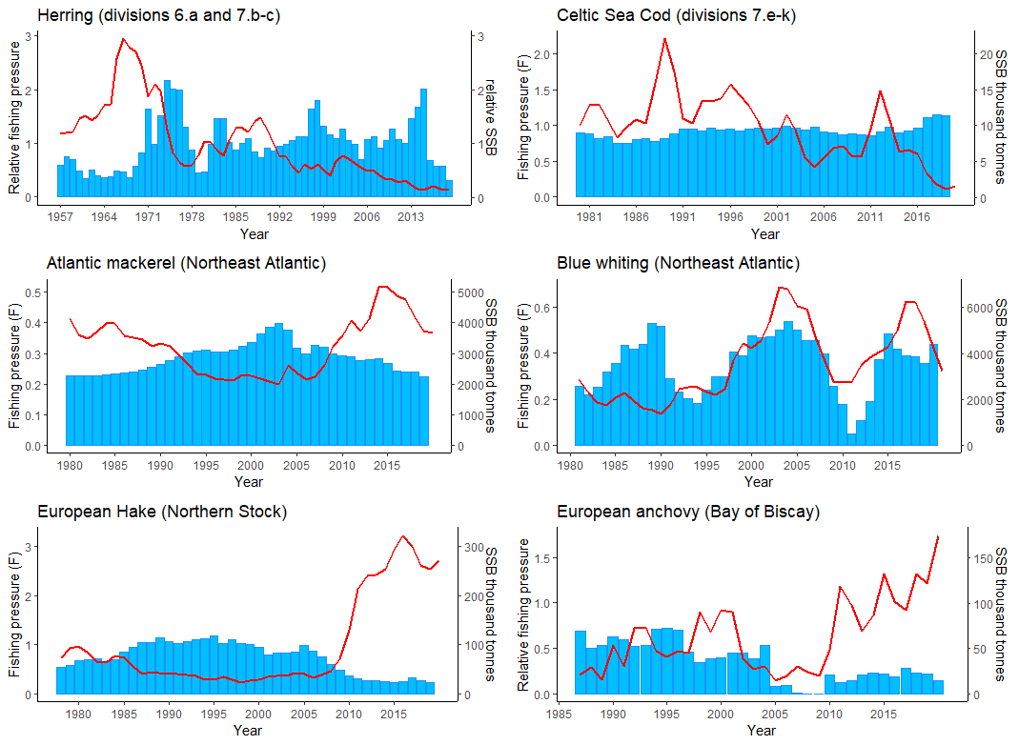
Societal Concerns: 4. Major Fish Stocks
Spawning stock biomass
Fishing pressure
Herring (Boreal)
Cod (Boreal)
Atlantic mackerel (Migratory)
Blue whiting (Migratory)
European hake (Lusitanian)
European anchovy (Lusitanian)
Major Societal Concerns: 4. Major Fish Stocks
Figure 3: Fishing pressure (blue bars) and spawning stock biomass (red line) of four major commercial species in the Irish marine region. Note: different time scales over which reliable data are available (http://standardgraphs.ices.dk/stockList.aspx).
Update Meeting: 24/09/2021
Louise Vaughan
(Courtesy Louise Vaughan, ClimFish
Notes:
We are already observing changes in the distribution and abundance of some of our key fish species. We are seeing decreases in cold water species like herring and cod and increases in warm water species like hake. A very cursory view could be that we will be eating exotic new species as our climate warms, like the picture on the left shows. We need to understand the implications of such changes in key fisheries in our waters so that we can provide the best management advice to fishers in the future.

Slide 12
Societal Concerns: 4. Major Fish Stocks
Major Societal Concerns: 4. Major Fish Stocks
Update Meeting: 24/09/2021
Louise Vaughan
(Snake pipefish
(European anchovy
(Courtesy Louise Vaughan, ClimFish
Notes:
We are already observing changes in the distribution and abundance of some of our key fish species. We are seeing decreases in cold water species like herring and cod and increases in warm water species like hake. A very cursory view could be that we will be eating exotic new species as our climate warms, like the picture on the left shows. We need to understand the implications of such changes in key fisheries in our waters so that we can provide the best management advice to fishers in the future.

Slide 13
5. Seabirds
Species | Feeding guild | Birds of Conservation Concern in Ireland (BOCCI) 2020-2026 | European Red List of Birds (BirdLife International) 2021 | Vulnerability to climate change
Northern Fulmar Fulmarus glacialis | Surface feeder | A | VU | 1
Manx Shearwater Puffinus puffinus | Surface feeder | A | LC | 2
Storm Petrel Hydrobates pelagicus | Surface feeder | A | LC | 2-3
Leach's Petrel Oceanodroma leucorhoa | Surface feeder | R | NT | 0-1
Northern Gannet Morus bassanus | Water column feeder | A | LC | 0-1
Cormorant Phalacrocorax carbo | Water column feeder | A | LC | 2
Shag Phalacrocorax aristotelis | Water column feeder | A | LC | 2
Great Skua Stercorarius skua | Surface feeder | A | LC | 0-1
Kittiwake Rissa tridactyla | Surface feeder | R | VU | 2
Black-headed Gull Chroicocephalus ridibundus | Surface feeder | A | LC | 1
Mediterranean Gull Ichthyaetus melanocephalus | Surface feeder | A | LC | 1
Common Gull Larus canus | Surface feeder | A | LC | 1
Lesser black-backed Gull Larus fuscus | Surface feeder | A | LC | 1
Herring Gull Larus argentatus | Surface feeder | A | LC | 1
Great Black-backed Gull Larus marinus | Surface feeder | G | LC | 1
Little Tern Sternula albifrons | Surface feeder | A | LC | 3
Sandwich Tern Sterna sandvicensis | Surface feeder | A | LC | 2
Common Tern Sterna hirundo | Surface feeder | A | LC | 2
Arctic Tern Sterna paradisea | Surface feeder | A | LC | 2
Roseate Tern Sterna dougallii | Surface feeder | A | LC | 2
Common Guillemot Uria aalge | Water column feeder | A | LC | 1
Razorbill Alca torda | Water column feeder | R | LC | 1
Black Guillemot Cepphus grylle | Water column feeder | A | LC | 1-2
Puffin Fratercula arctica | Water column feeder | R | EN | 2
Approximately half of seabird species globally have declining population trends.
89% of seabirds impacted by climate change are also affected by other threats such as overfishing, hunting/trapping and disturbance. It is difficult to estimate the impact of climate change on Irish seabird populations given the myriad of threats they currently face.
Little Terns may be the most vulnerable to sea-level rise as well as species that nest on coastal beaches such as Ringed Plover.
Seabird mortality during cyclones is likely caused by starvation, as seabirds cannot effectively find prey in these extreme conditions. Storms in in 2013/2014 resulted in wrecks of over 50,000 seabirds on the coastline of Europe.
(Courtesy: Power et al (in prep)

Slide 14
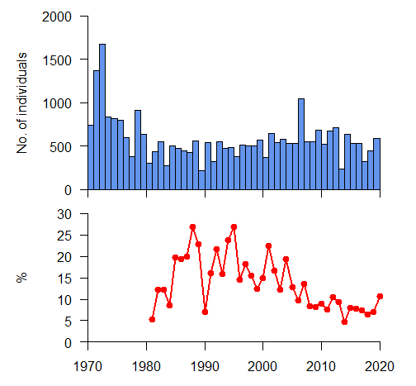
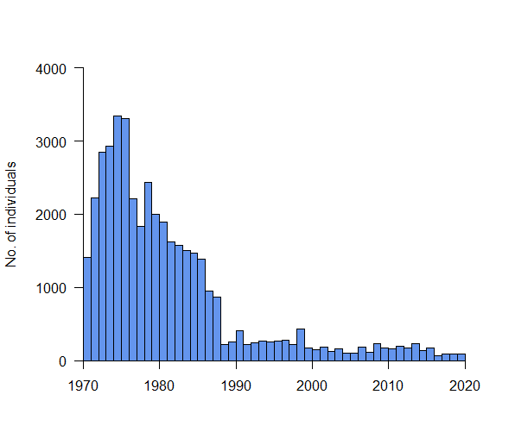
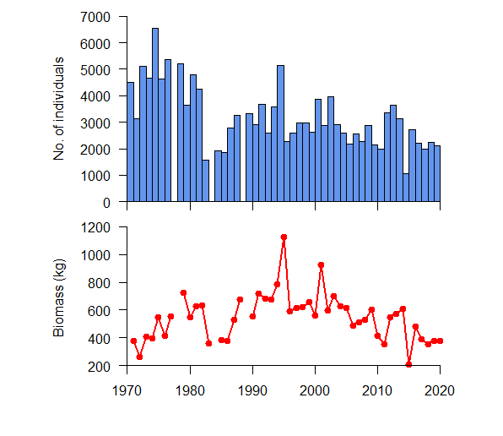
6. Land ocean aquatic continuum (Burrishoole)
(Salmon
(Trout
(Eel
Figure 7 Annual wild grilse 1 sea winter salmon counts (top) and % marine returns (bottom) for the Burrishoole catchment, 1971-2020 (Marine Institute Data).
Figure 8 Annual count of trout, returning to the Burrishoole catchment, to spawn between 1971-2020 (Marine Institute Data).
Figure 9 Annual count of silver eel (top), and total biomass of silver eel (bottom) leaving the Burrishoole catchment, 1971-2020 (Marine Institute Data).
(Courtesy: De Eyto at al (in prep)

Slide 15
https://oar.marine.ie/handle/10793/1844
Notes:
Atmospheric drivers
Physical Oceanography
Ocean Chemistry
Phytoplankton
Commercial Fisheries
Seabirds
Land ocean aquatic continuum
Ocean modelling
Infrastructure

Slide 16
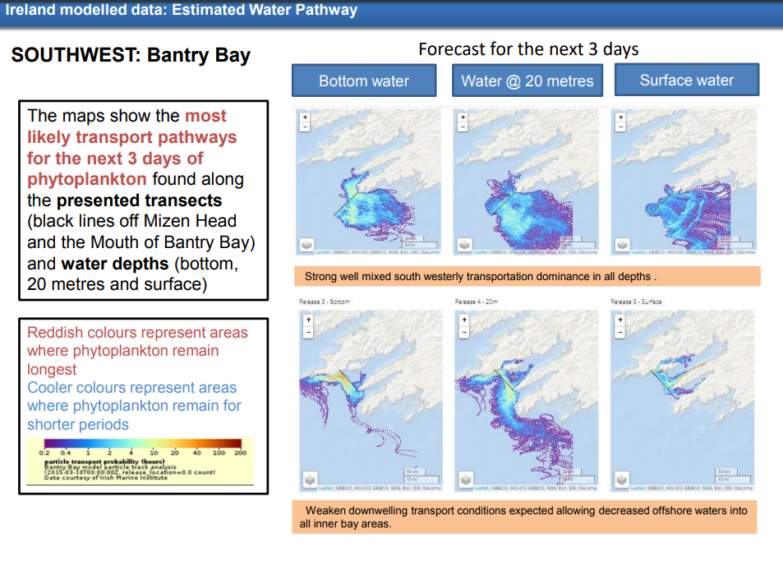
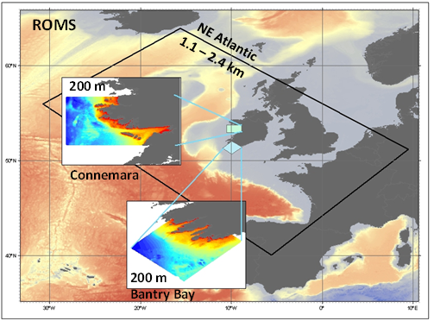
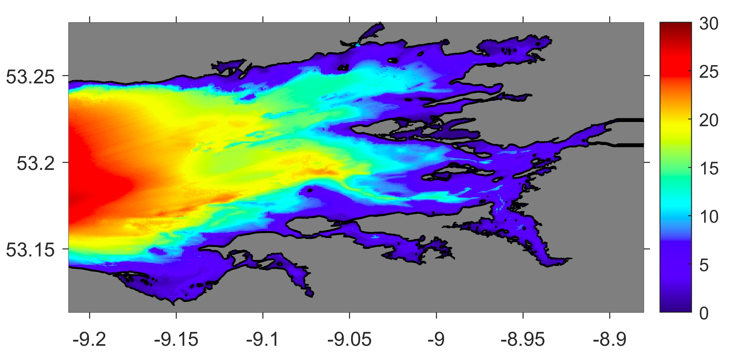
Operational Modelling
Contributes to part of the weekly HAB bulletin
Inner GB 70 m

Slide 17
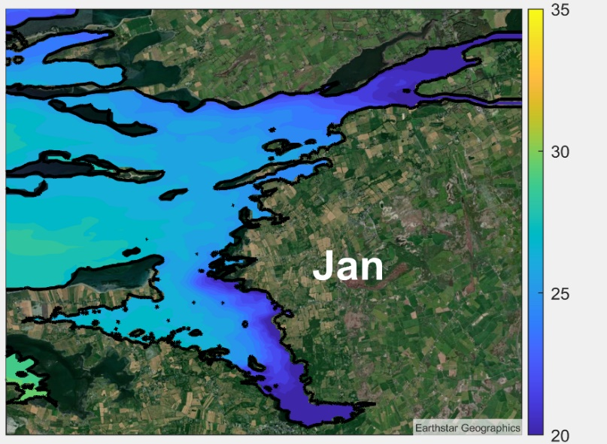
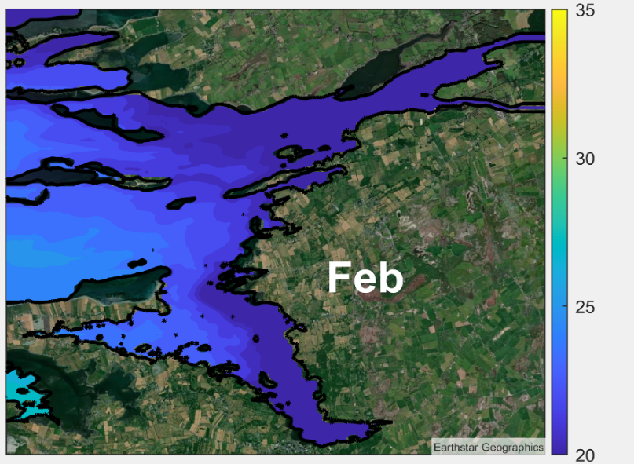
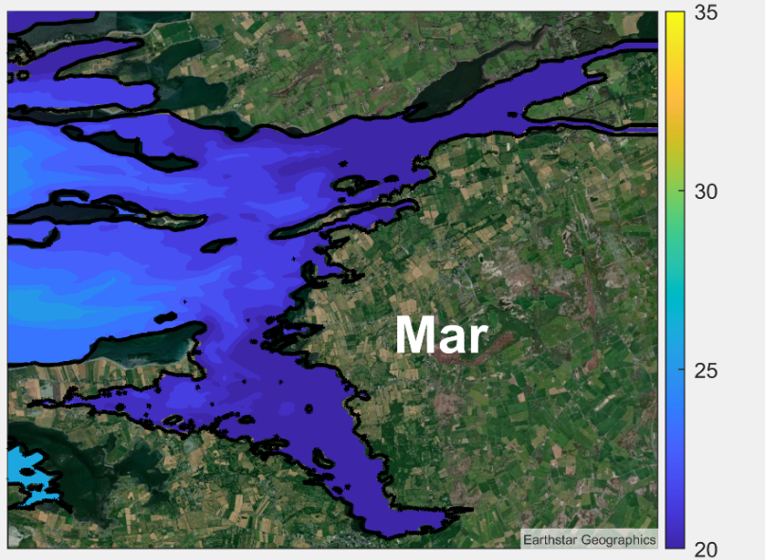
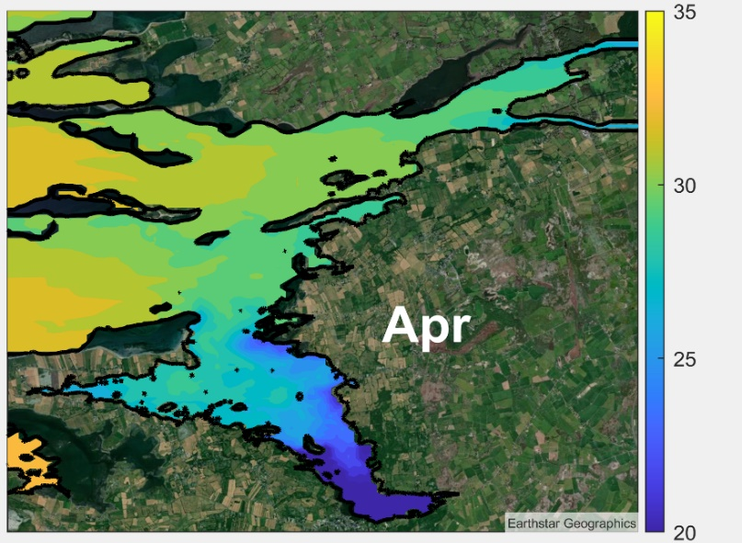
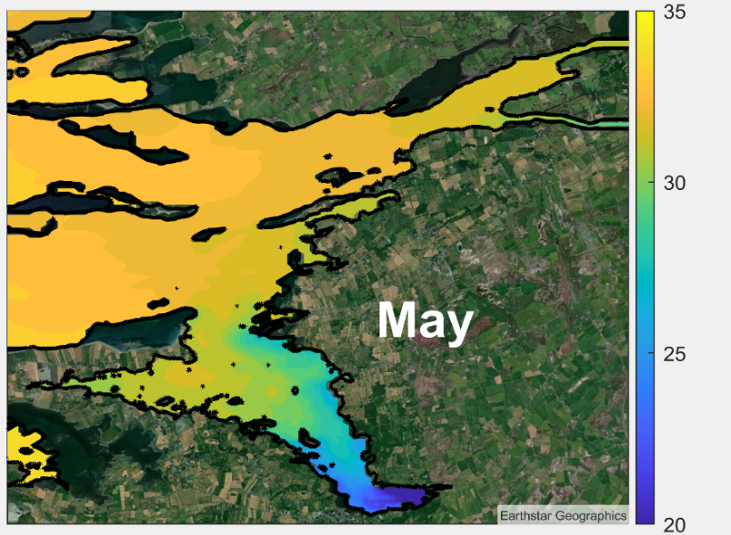

Operational Modelling
Salinity Distribution: Oyster Cultivation

Slide 18
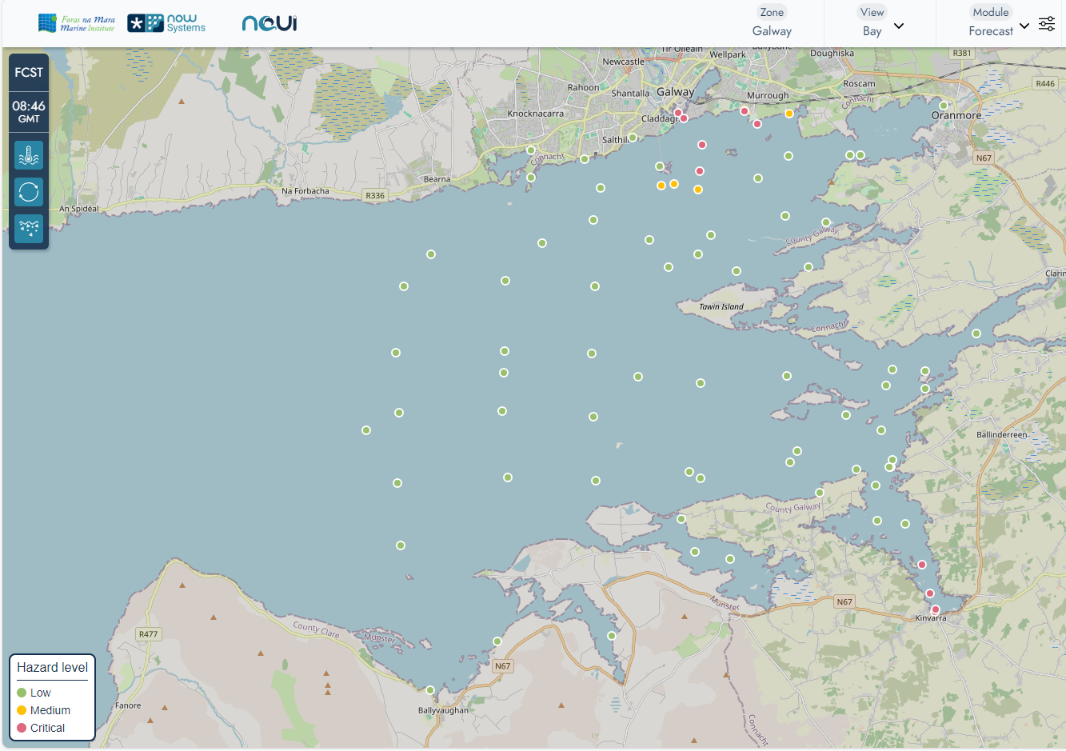
NAUI Graphical User Interface
NAUI
Three different services provided:
Forecast (temperature, salinity and currents)
Real-time (observed sea level, wave height and temperature)
Climate view (long-term statistical values)

Slide 19
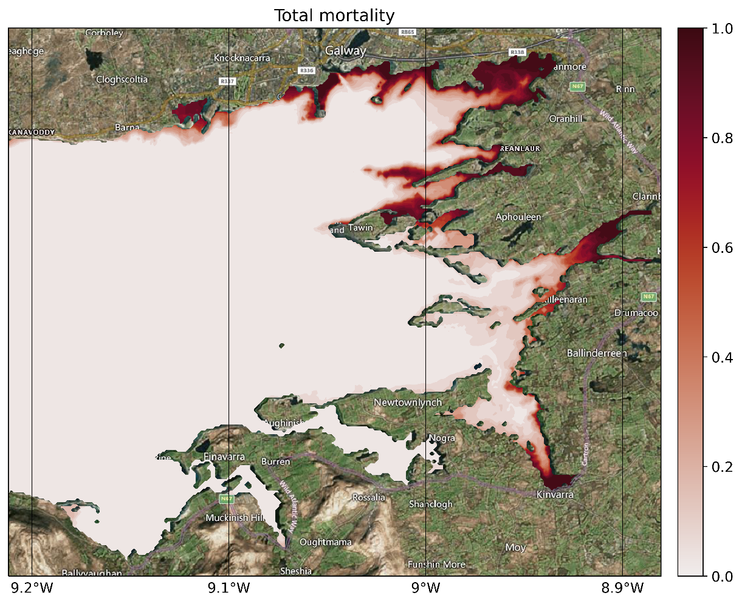
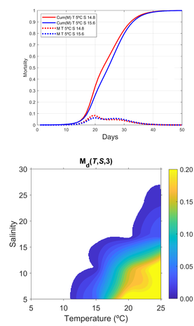
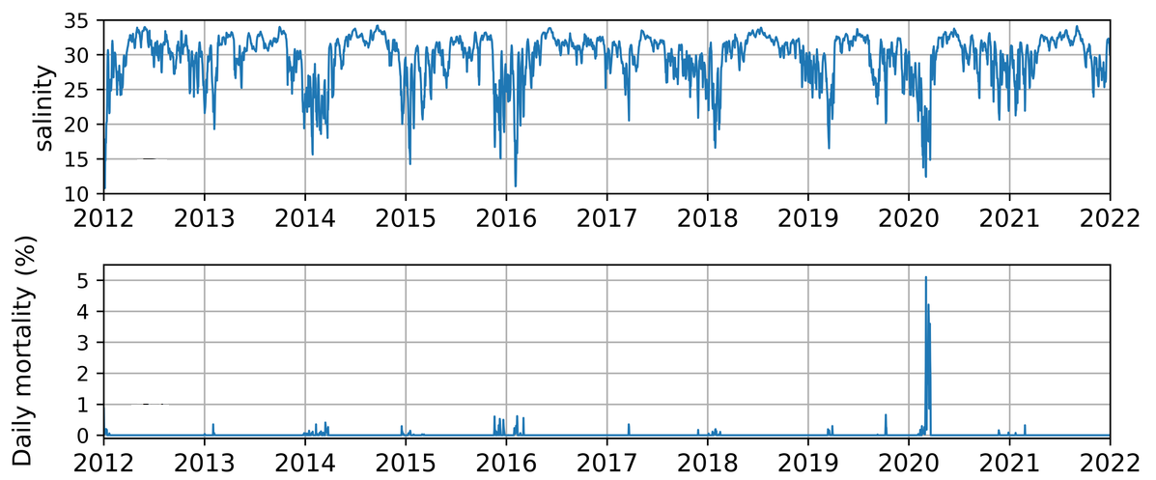
Estimation of oyster mortality

Slide 20
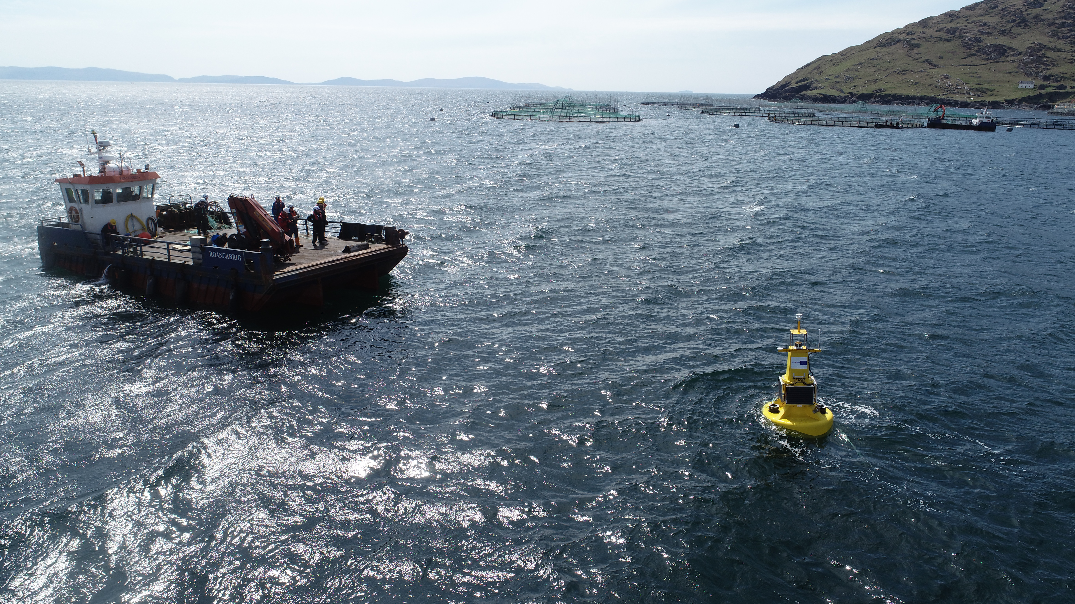
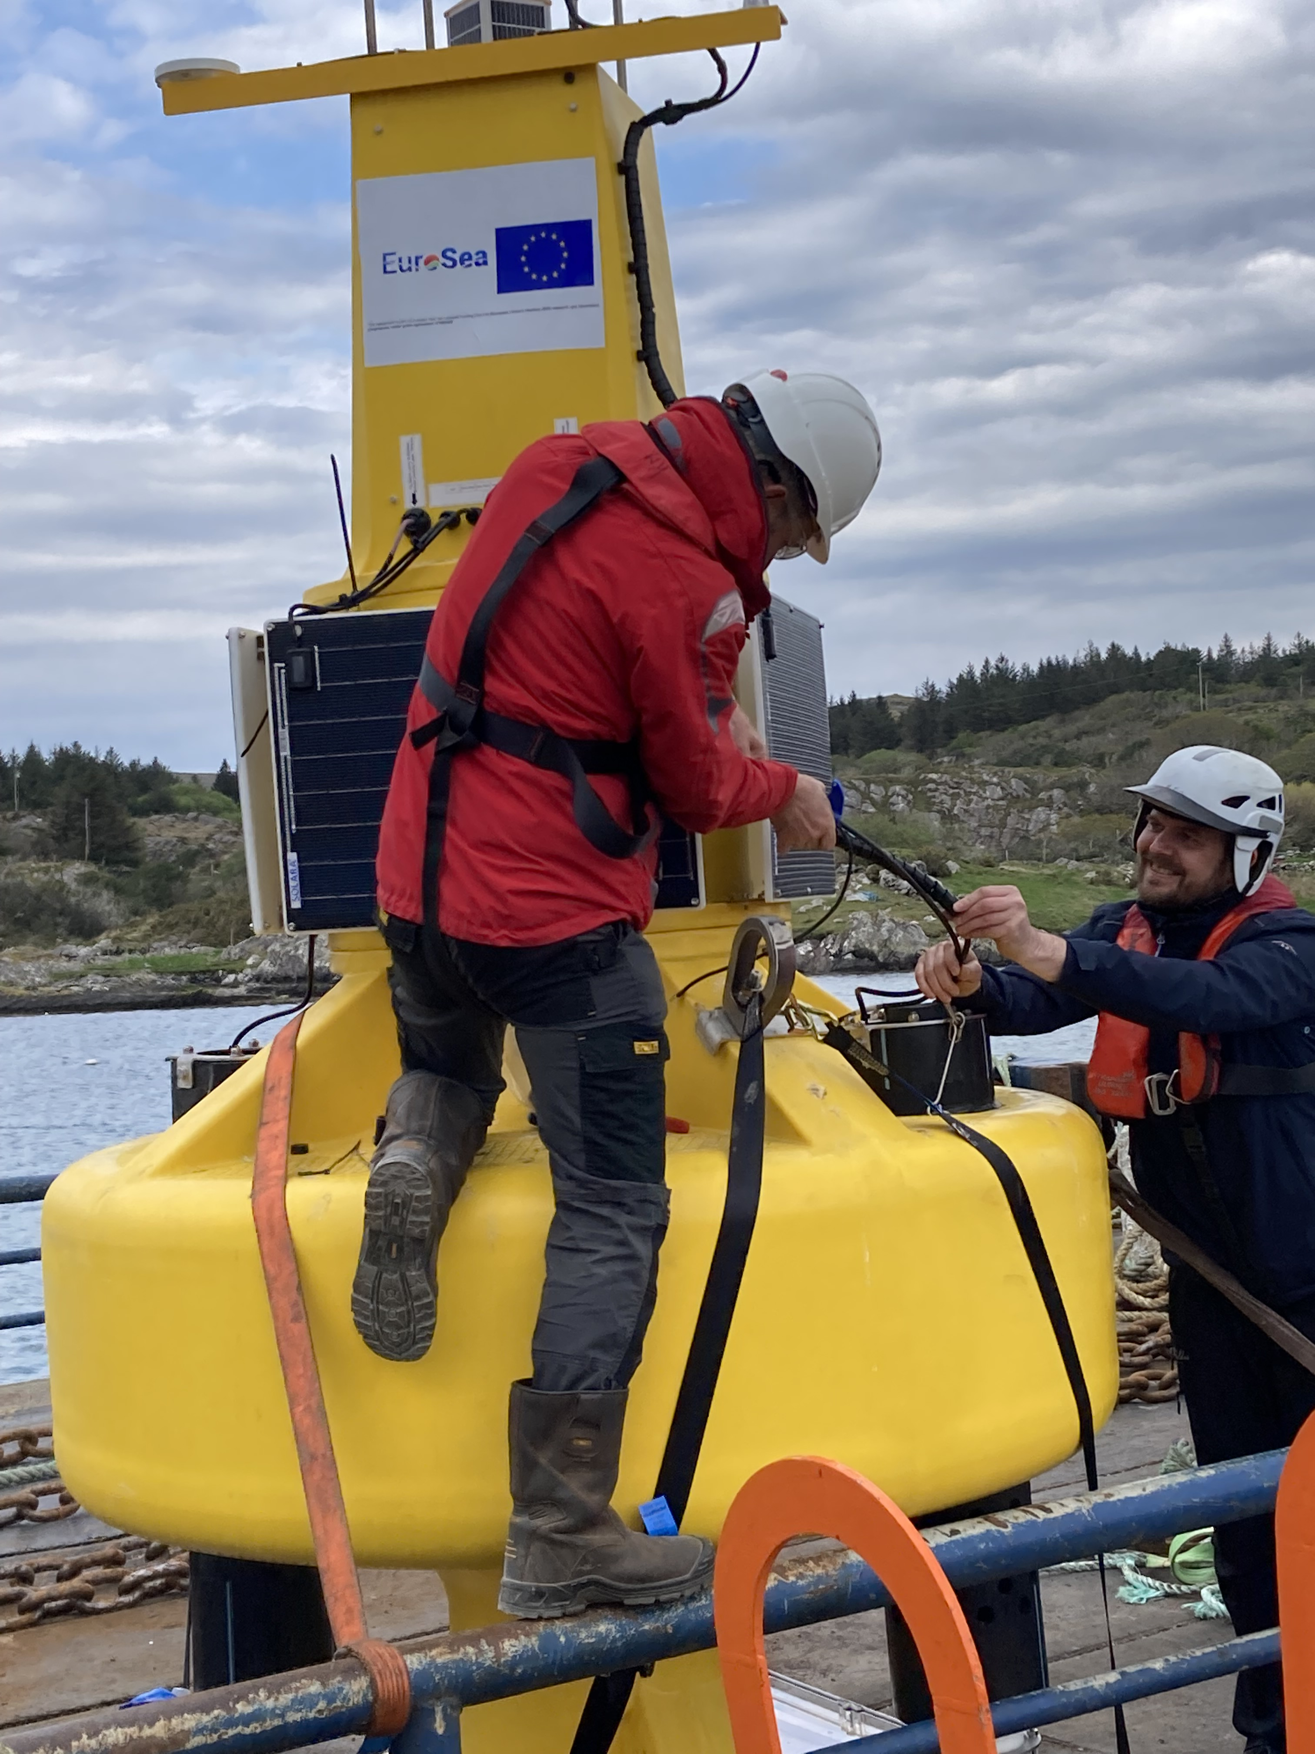
Marine Observatory for Aquaculture
Combining Ocean Observations & Numerical Modelling
“Extreme Marine Events” Ocean Observing & Forecasting
Bespoke web portal to display oceanographic data and ocean warnings
Essential Ocean Variables: water currents, wind, oxygen, temperature, salinity, pH, chlorophyll, turbidity
https://eurosea.marine.ie

Slide 21
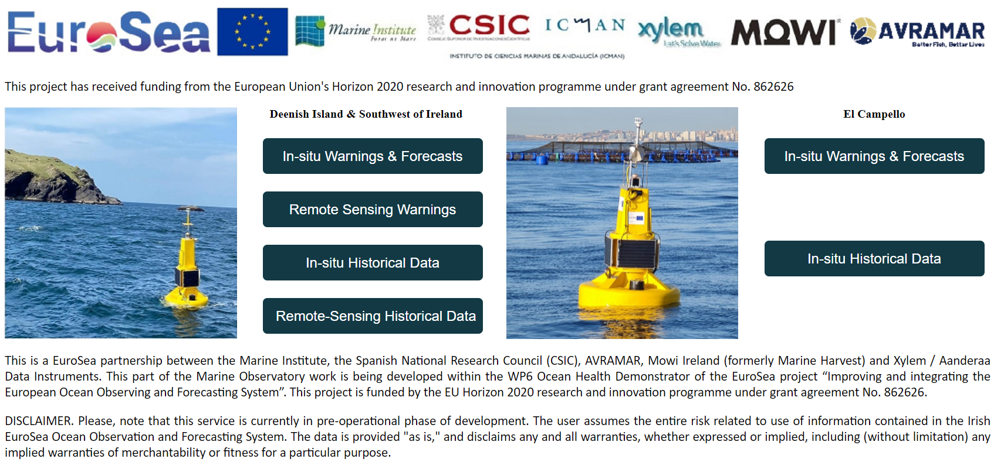



Marine Observatory for Aquaculture
Combining Ocean Observations & Numerical Modelling
“Extreme Marine Events” Ocean Observing & Forecasting
Bespoke web portal to display oceanographic data and ocean warnings
Essential Ocean Variables: water currents, wind, oxygen, temperature, salinity, pH, chlorophyll, turbidity
https://eurosea.marine.ie

Slide 22












Marine Observatory for Aquaculture
Combining Ocean Observations & Numerical Modelling
“Extreme Marine Events” Ocean Observing & Forecasting
The increasing frequency, duration and intensity of Marine Heat Events, such as Marine Heat Waves (MHWs) are of great concern for a wide range of stakeholders, including aquaculture farmers. Current conditions and forecasts on MHWs are provided as a 2D visualization maps, highlighting the affected areas.
https://eurosea.marine.ie

Slide 23













Warm and cold years: highly variable
2012 964
2013 879
2014 944
2015 911
2016 921
2017 964
2018 863
2019 940
2020 903
2021 921
2022 935
2023 971
2024 972

Slide 24

Marine heatwaves 2023

Slide 25


Year to year variability can be significant

Slide 26
Remote Sensing | Marine Institute
https://www.marine.ie/site-area/data-services/remote-sensing/remote-sensing

Slide 27






Thank you
www.marine.ie
@marineinstituteireland
@marineinstitute
@marineInst
@marineinstituteireland
@marineinstituteIRL

