Slide 1



Slide 2

Aquatech Innovations
Aquatech is a any product or service that enables the sustainable production of seafood.
Ireland has an ambition to be a global leader in aquatech (Food Vision 2030)

Slide 3

Aquatech Innovations
AuraAqua Product
Natural Functional ingredient to support Fish Health and performance
Promising results on Piscirickettsia
Trials commencing this year

Slide 4
Salmon – P. salmonis

Slide 5

Aquatech Innovations
Submersible long line technology
Trial line deployed in Connemara and Bantry
robust and simple flotation technology for longlines and that can attenuate wave loads, while offering buoyancy control to compensate for biomass growth

Slide 6
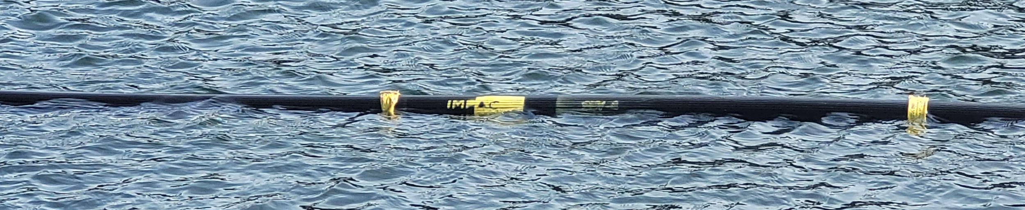
https://impact-9.com/products

Slide 7

Aquatech Innovations
Technology targeting Health and safety in vessels at sea
The biggest safety issue in fish farming involves the transfer of crew from vessels (feed vessels, support vessels, visitor craft
Remotely deployed gangway

Slide 8
https://www.youtube.com/watch?v=19HtJHMhfXE

Slide 9


Slide 10
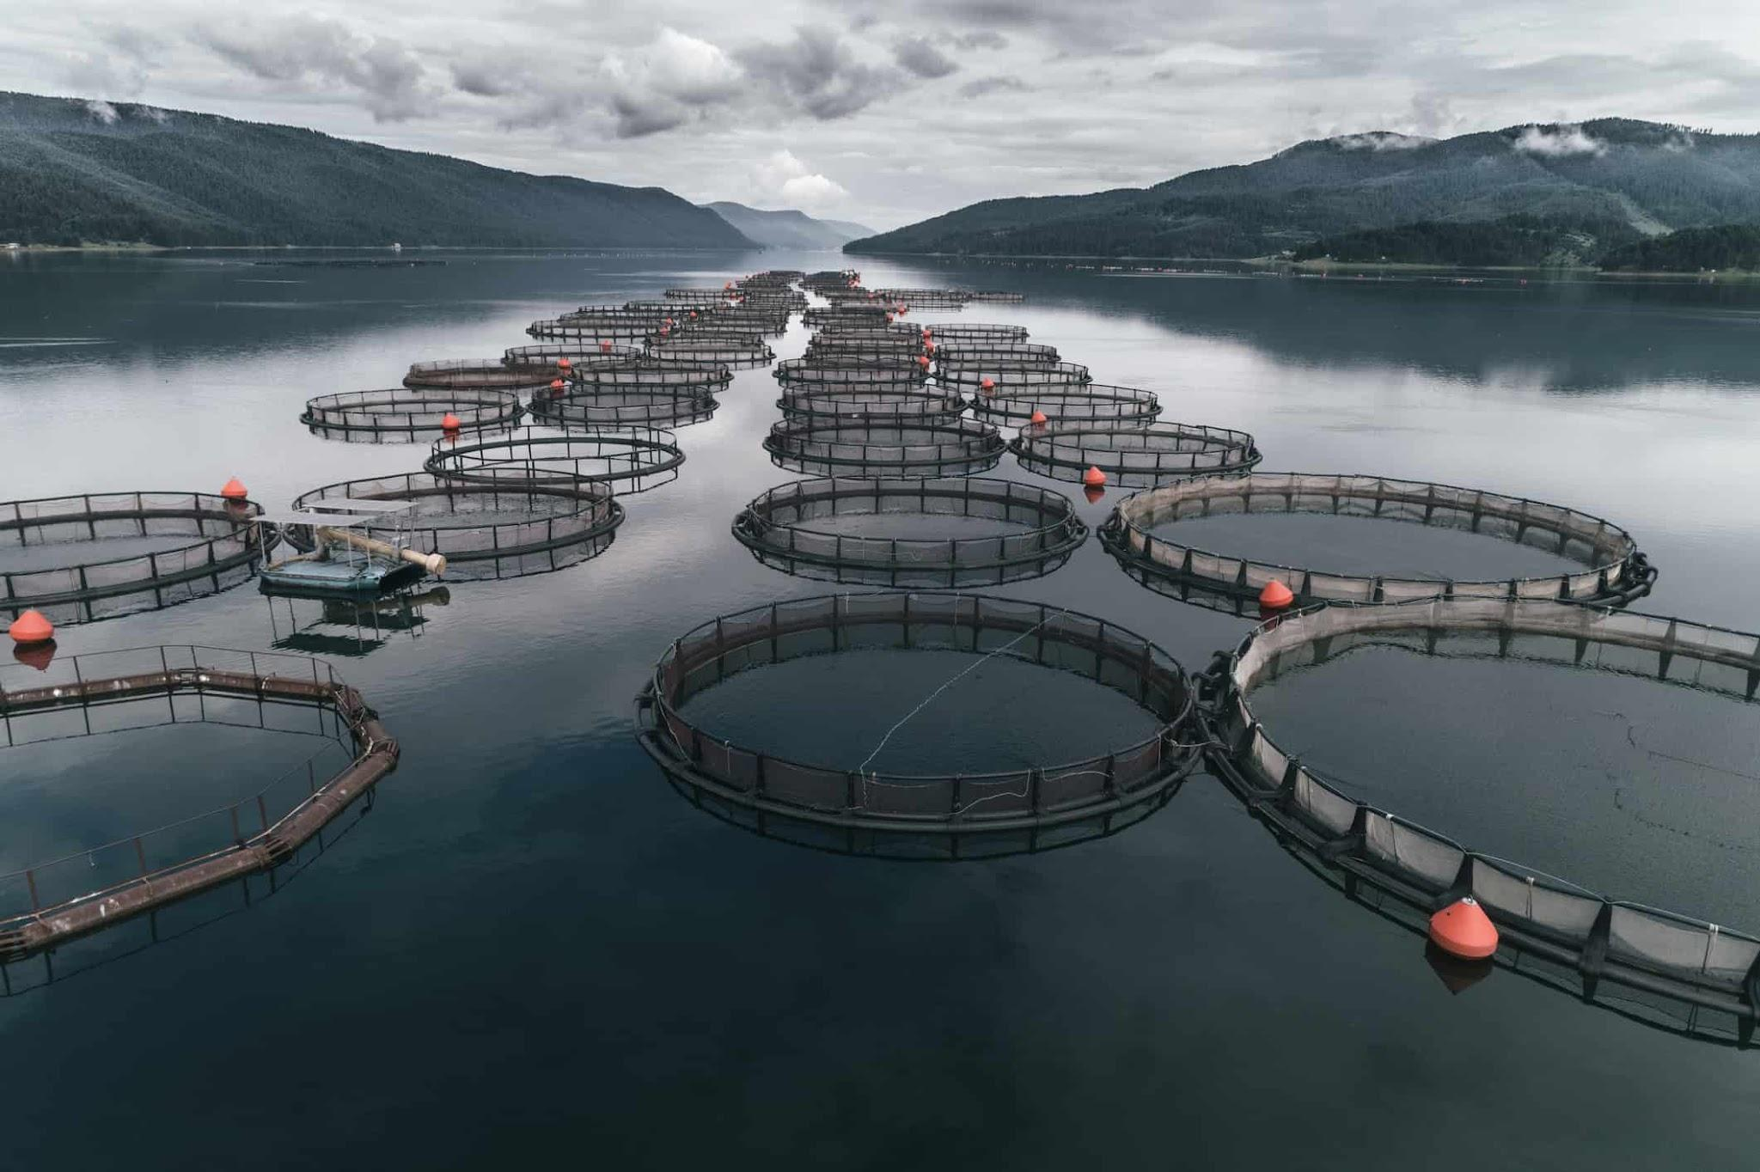

Opportunities in AquaTech
IFA Aquaculture Conference
March 20, 2025

Slide 11
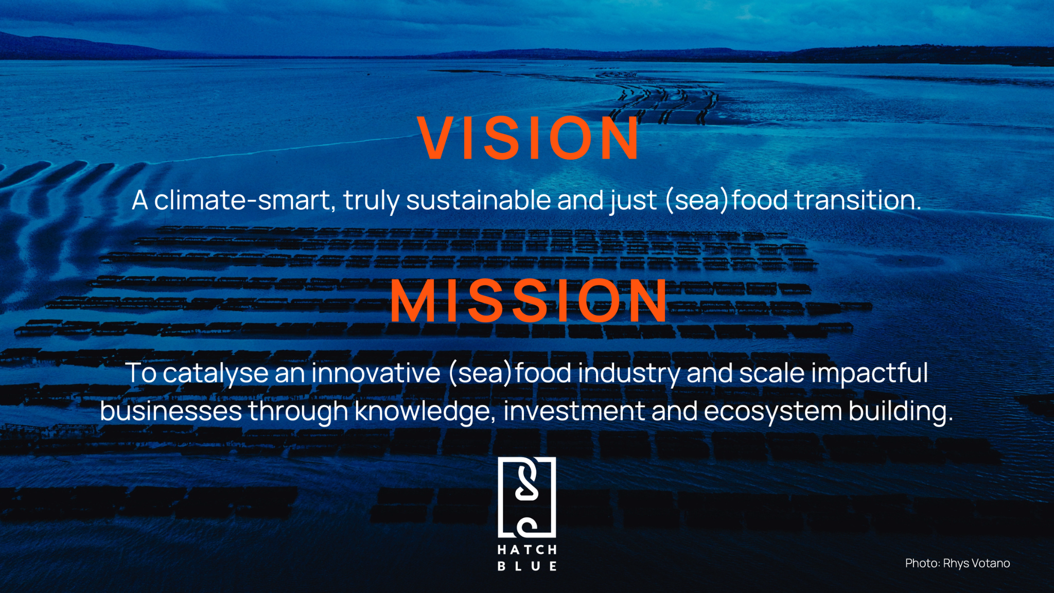

Slide 12
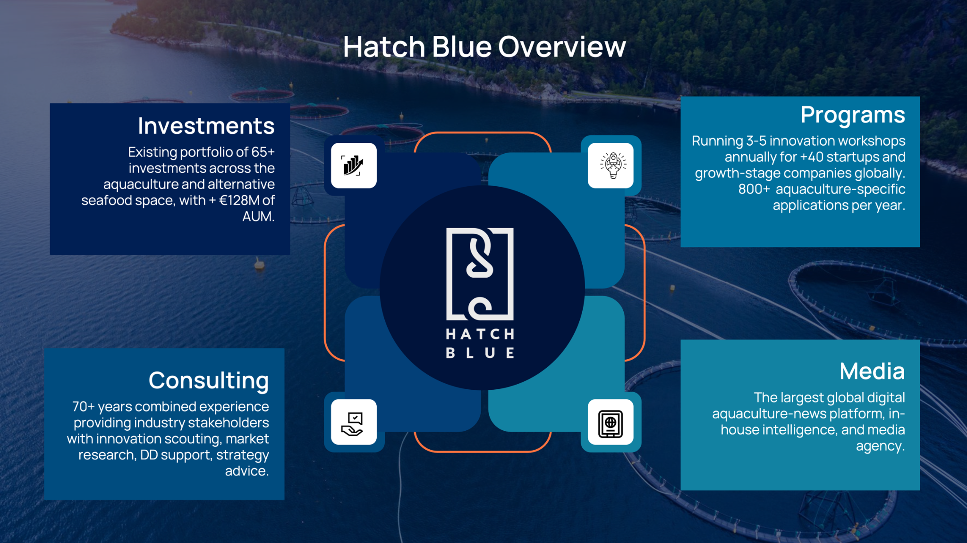

Slide 13
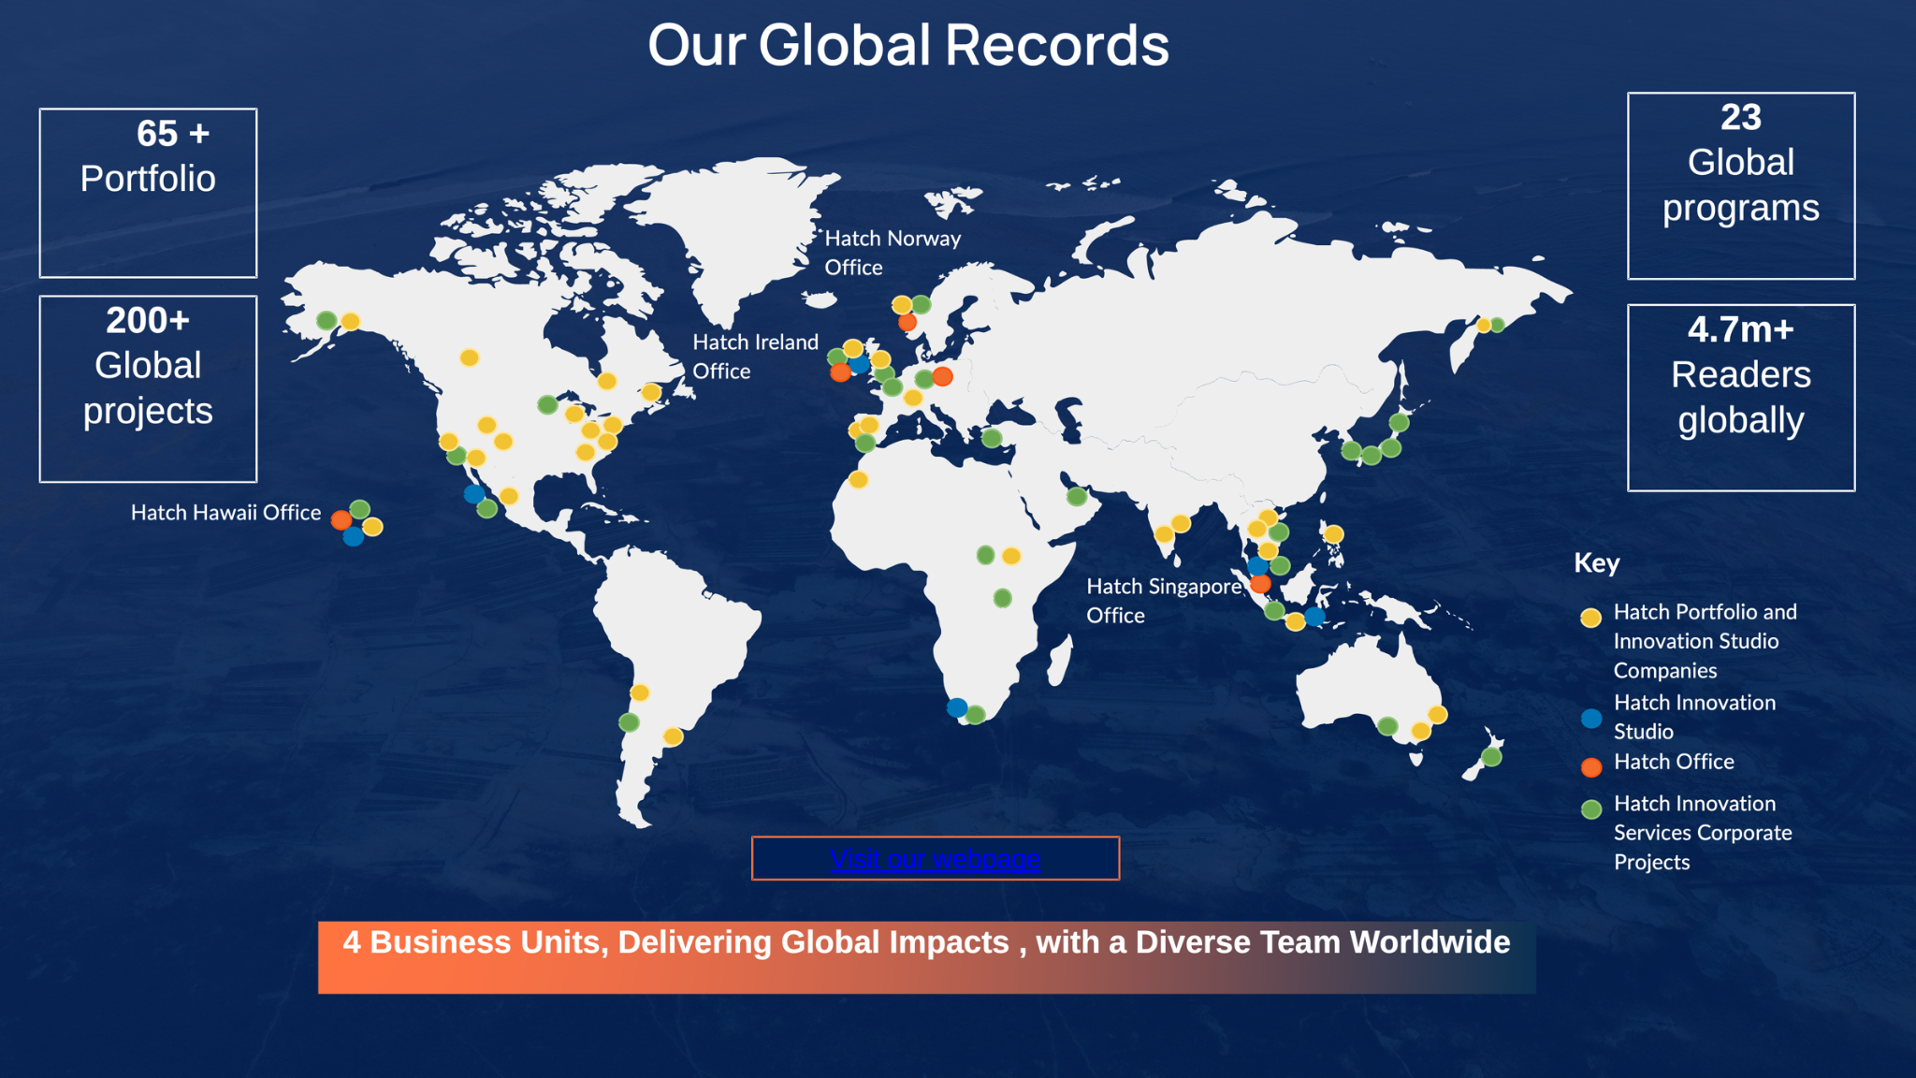

Slide 14












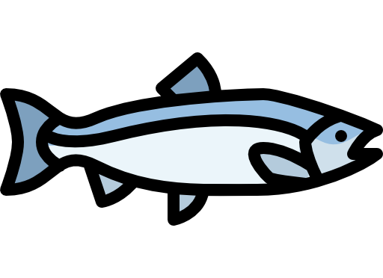











The Aquaculture Supply Chain
Trimmings & by-products Excl. animal by-products
Fresh water
Eggs and seed
Fresh water
Speciality / micro ingredients Incl. vitamins, minerals, pigments
Equipment
Services
Packaging
Byproducts
Medicine
Land animal ingredients
Mortality rate
Energy
Formulation Incl. inclusion rates of each distinct ingredient
FCR
Formulated Feed
Consumer* simplified
Terrestrial ingredients incl. meals and oils
Feed milling
Farming activity
Processing
eFCR
Shipping
Air transport
Land transport
Survival rate
Processing efficiency
Energy
Feed consumption
Other co-products
Productivity
Discharge rates & recirculation / bioremediation activity
Ice / cold storage
Farm land change (mainly ponds and RAS)
Fish meal and other marine dry matter
Fish oil and other marine oils
Land utilization
Genetic quality
Cut-offs / Trimmings
Images from: https://www.flaticon.com/free-icons; https://icon-icons.com; www.freepik.com; https://www.istockphoto.com; https://www.svgrepo.com/
Notes:
FCR = feed given / animal weight gain — eFCR = amount of feed required to produce one kilo of farmed salmon

Slide 15
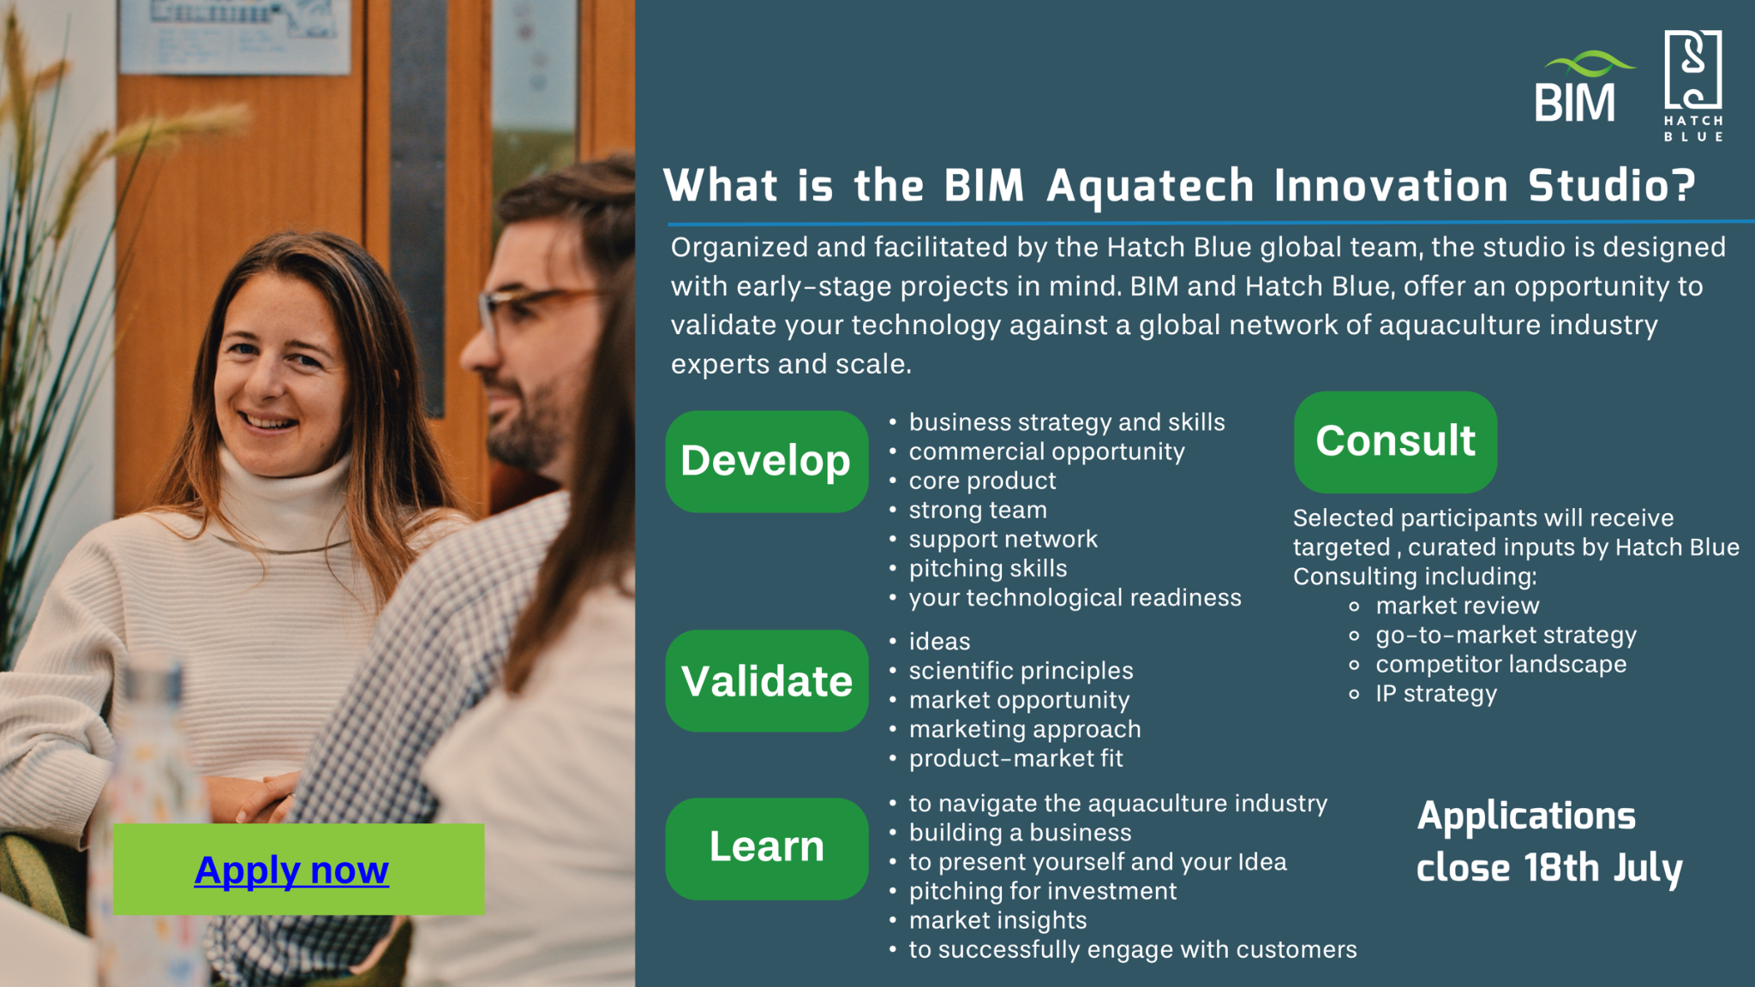

Slide 16
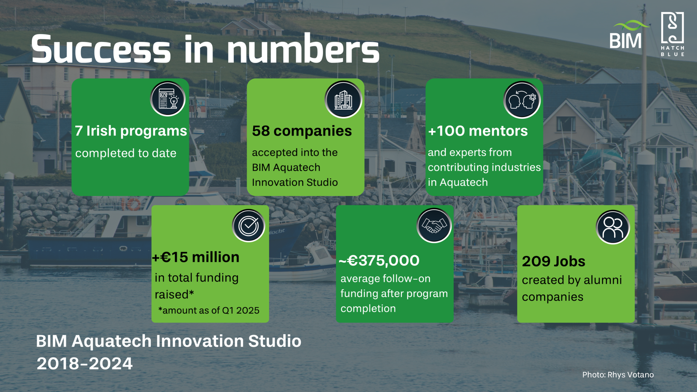

Slide 17




Slide 18


Aquahack
The mission of AquaHack is to stimulate aspiring entrepreneurs to develop and commercialize ideas and/or research by forming companies that solve food security and technology gaps in the blue bioeconomy sector and have significant social, environmental, and economic impacts for Ireland.
April 3rd, Dún Laoghaire
Early career researchers and PhD students in the blue bioeconomy
What are your pain points and challenges?
Jessica@hatch.blue

Slide 19
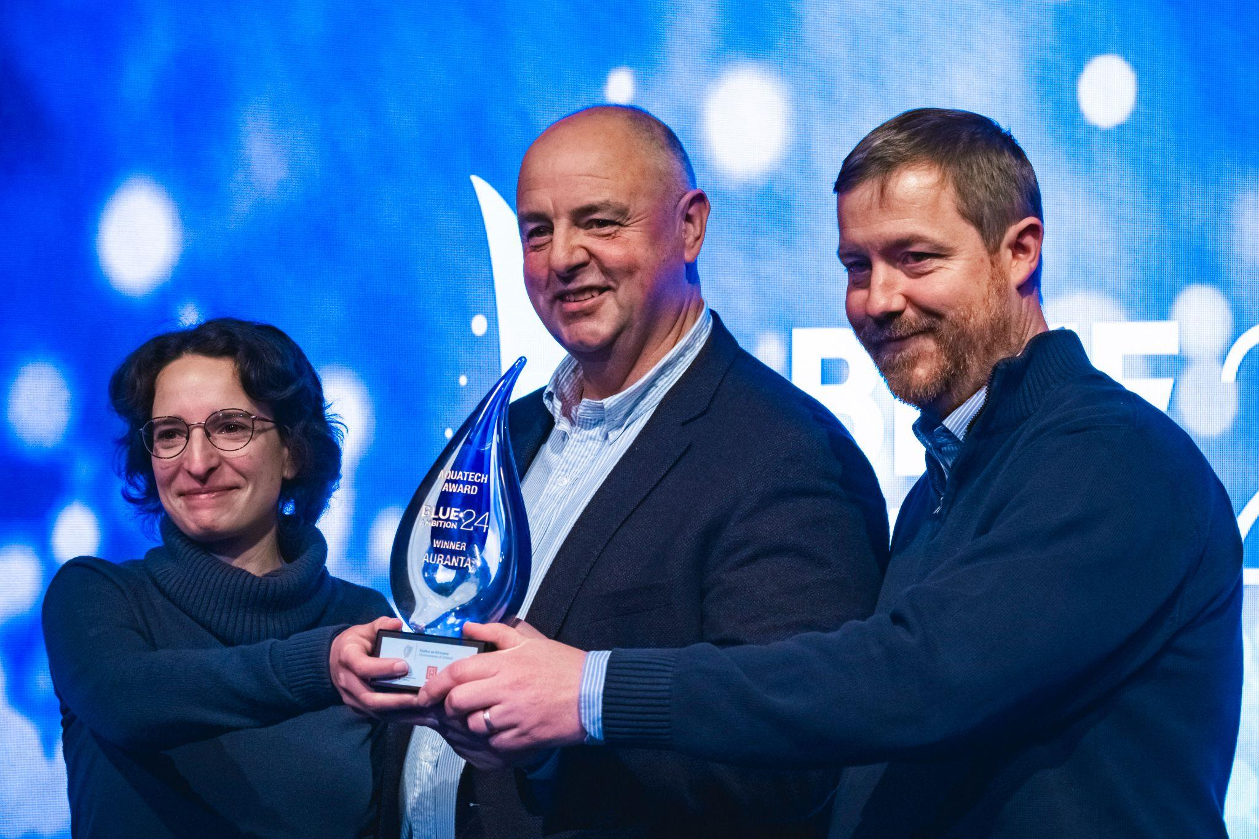
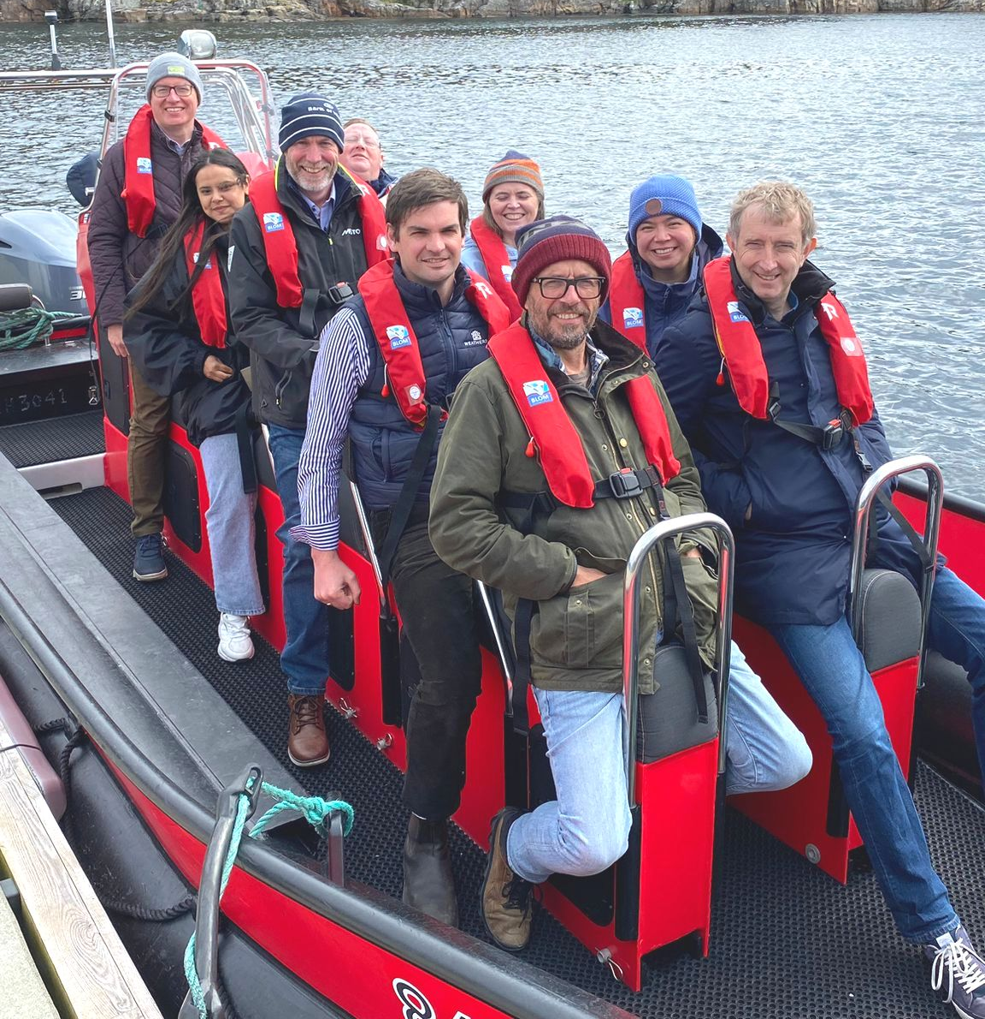
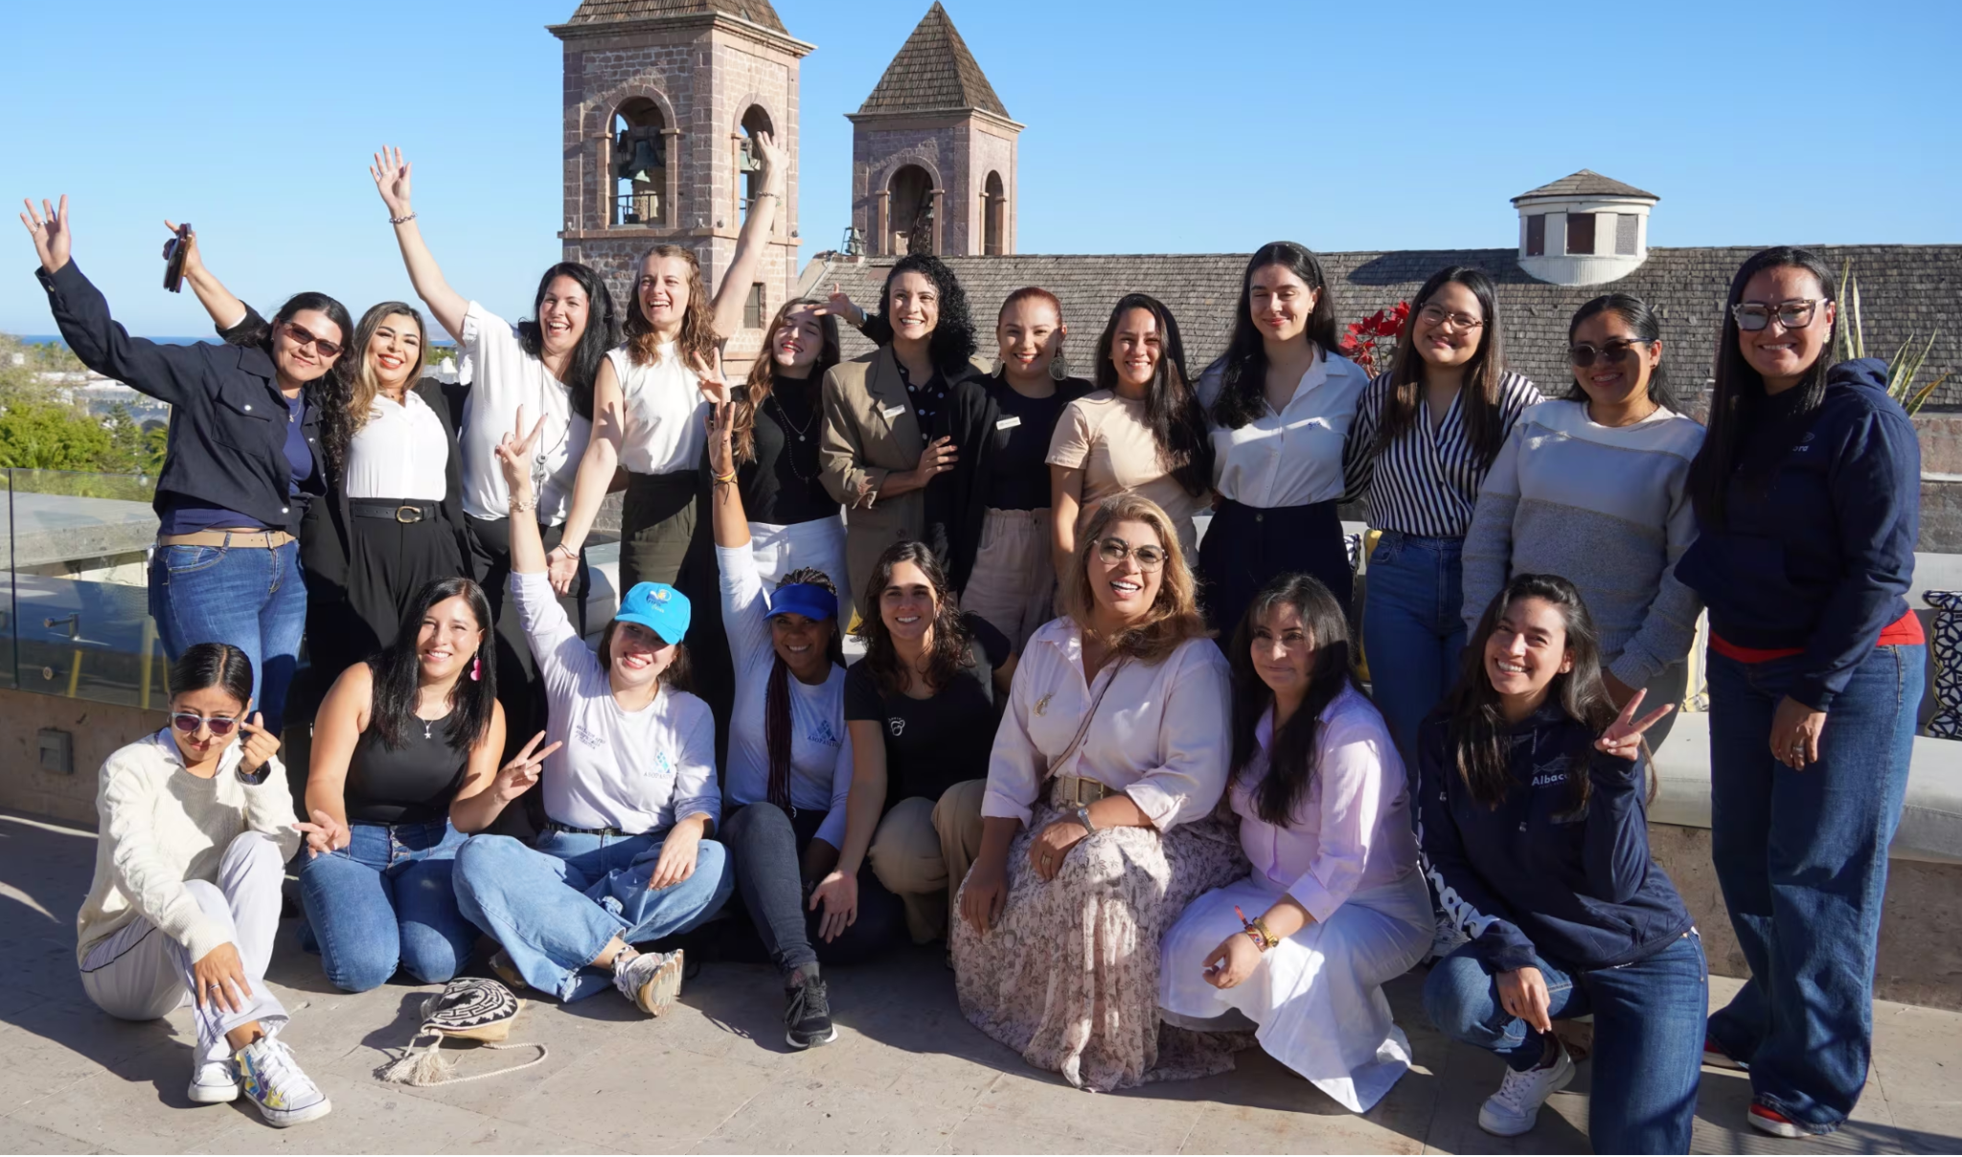
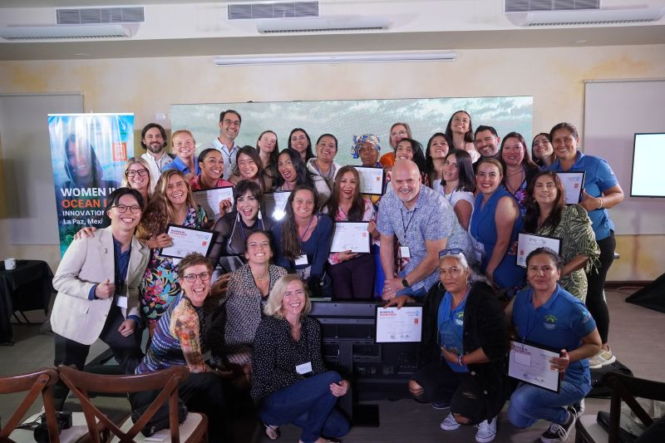
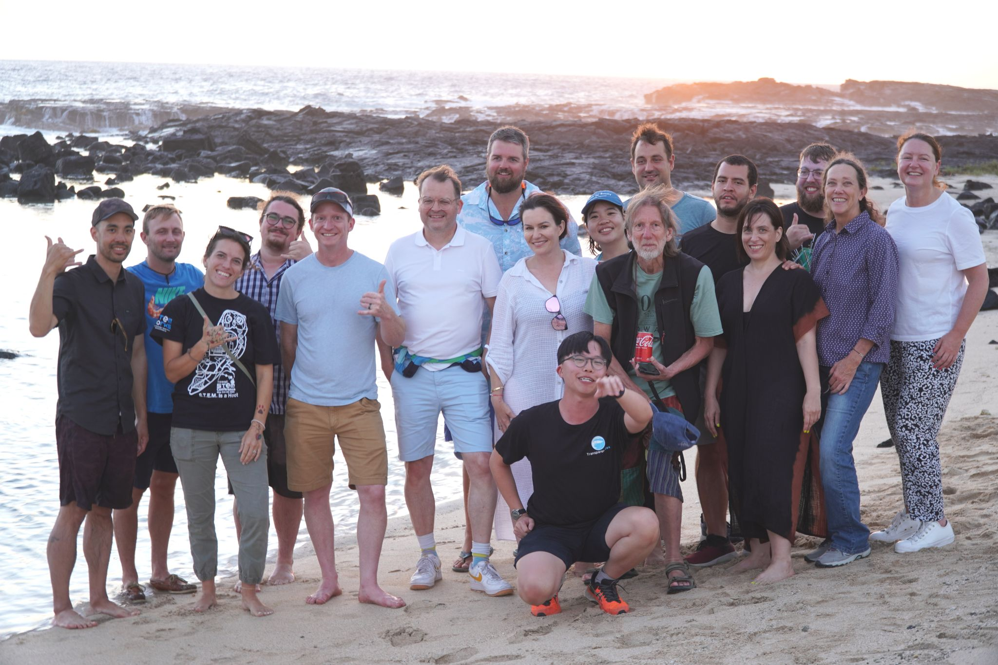
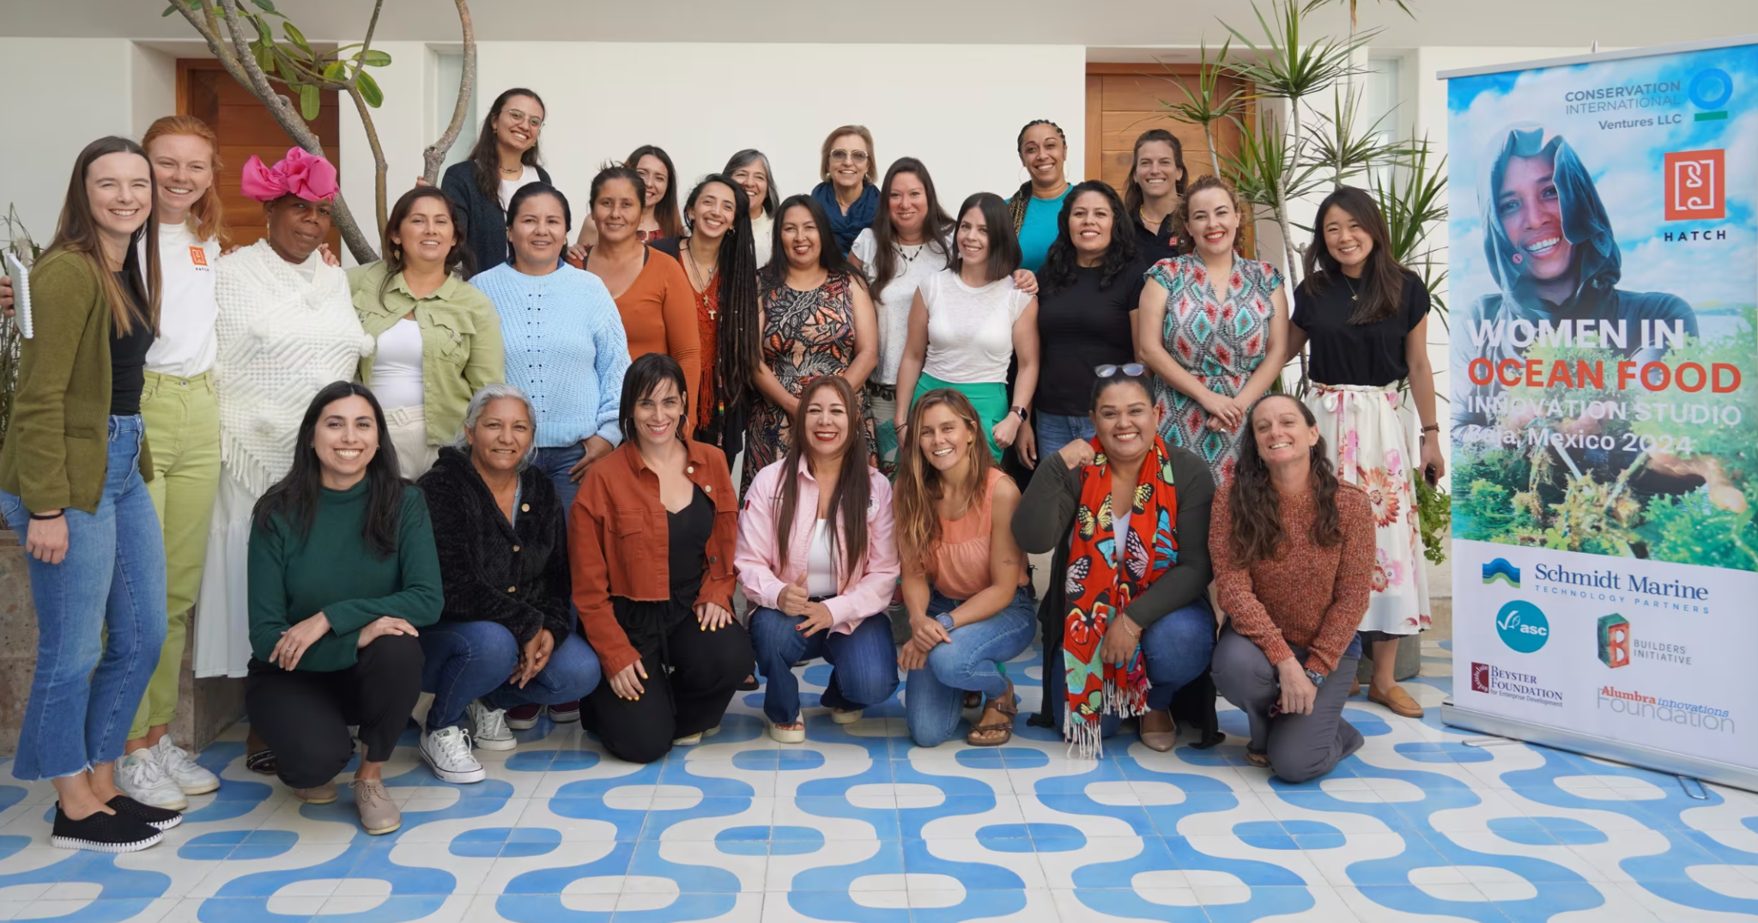
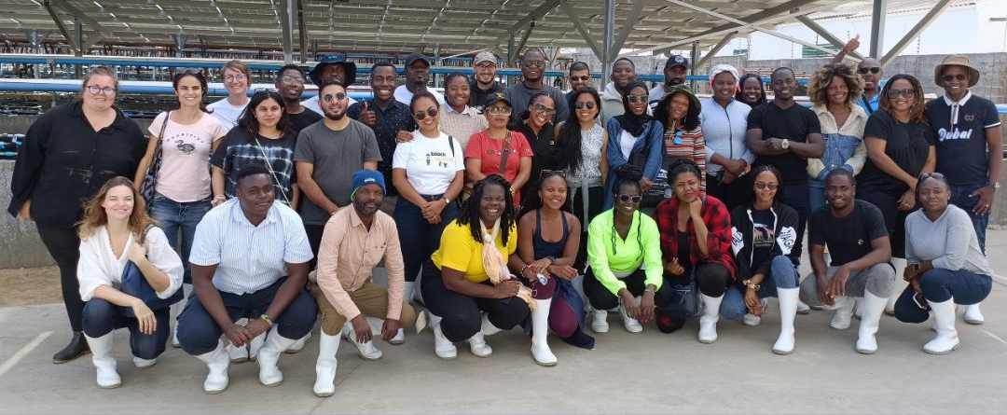

Slide 20
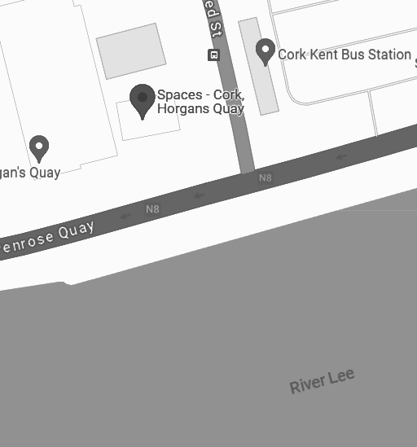
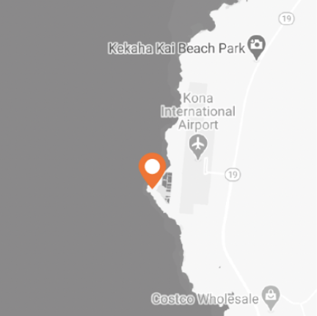
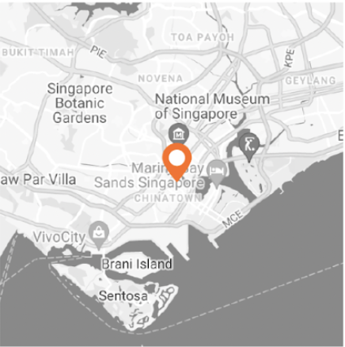
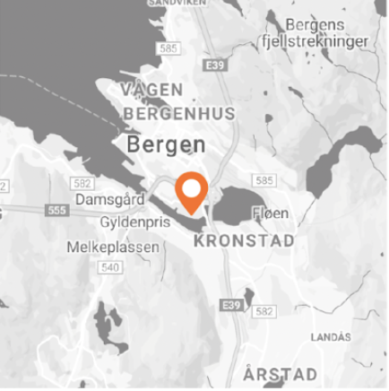

Get In Touch or Visit Us
We have a global footprint, with an ongoing presence in all our locations. Feel free to contact us by email and sign up for our mailing list on our website.
Ireland
Hawaii
Singapore
Norway
Website
https://www.hatch.blue/
Email
info@hatch.blue

